Slide 1
Machine Learning in Practice I
Antal Jakovac, 2025

Slide 2


About the course
Course Title: "Machine Learning in Practice I"
instructor: antal.jakovac@uni-corvinus.hu
course objectives
  why and when to use Machine Learning (ML)
  data handling methods
  core ML models before deep learning
  how to build an ML project

Slide 3

About the course
about the course
  evaluation: written exams (together with exercises)
  learning material: course slides, books, podcasts, etc.
  books:
    An Introduction to Statistical Learning
    (G.James , D. Witten , T. Hastie , R. Tibshirani, https://www.statlearning.com/)
    Designing machine learning systems (Chip Huyen)
  github repository: https://github.com/ajakovac/ML-in-Practice-I

Slide 4
About the course
about the course
  evaluation: written exams (together with exercises)
  learning material: course slides, books, podcasts, etc.
  books:
    An Introduction to Statistical Learning
    (G.James , D. Witten , T. Hastie , R. Tibshirani, https://www.statlearning.com/)
    Designing machine learning systems (Chip Huyen)
  github repository: https://github.com/ajakovac/ML-in-Practice-I
#git clone project from command line
git clone https://github.com/ajakovac/ML-in-Practice-I.git
cd ML-in-Practice-I
#read the README.md file and follow instructions

Slide 5
Introduction

Slide 6
Introduction
why do we need Artificial Intelligence (Machine Learning)?
task of AI is not to solve an actual problem, but solve modelling
we do not know the model it uses → it can be smarter than us!
 | observation | modelling | computation | conclude/action
historic times | human | human | human | human
machines | machine | human | human | human
computers | machine | human | machine | human
AI | machine | machine | machine | human

Slide 7
Introduction
Traditional Programming vs. ML
  traditional: data + rules → output
  ML: data + output → rules
when to use ML?
  Automation of complex tasks → heuristics
  Adaptability
  Performance on large data
  Real-world examples (email spam, face detection, recommendation systems)

Slide 8


Introduction
Types of ML; traditionally
  supervised:
    show data + labels → learns the assignment
    examples: classification, regression
  unsupervised:
    find patterns in unlabeled data
    not unique → context, magnitude
    examples: clustering, dimensionality reduction
  reinforcement:
    learn by interacting with the environment
    not covered in this course
cats
dogs

Slide 9
Introduction
Types of ML; other points of view
  task-driven (System I)
    define a task (classification, prediction, control)
    show examples of good (eventually bad) solutions
    train models to optimize for success on that task
    includes most supervised/reinforcement learning examples
  data-driven (System II)
    reveal structures by showing similar data
    does not need explicit labelling
    LLM’s, autoencoders, similarity learning
    recently popular (self-supervised learning, foundation models, and retrieval-based systems)

Slide 10
Introduction
Typical ML tasks
  classification
    face, dog breeds, bird songs classification
    spam detection, disease diagnosis, sentiment analysis
    lot of labeled data
  regression (price prediction, weather forecasting, energy demand)
  clustering (customer segmentation, document grouping, biological cell types)
  compression (PCA, visualization, autoencoders, embeddings)

Slide 11
Introduction
Typical ML tasks
  decision making (robotics, game playing, resource allocation, monitoring)
  generation (text, translation, image, data, molecular structure, code)
  outlier analysis (email spam, suspicious customer, fraud detection, etc.)
  recommendation systems (movies, jobs, code completion, etc.)
  ranking/retrieval (search engines, document/data retrieval)

Slide 12

Introduction
somewhat overlapping areas; e.g. chemical plant monitoring system
  anomaly detection
  classification
  time-series forecasting
  reinforcement learning (control), recommendation systems

Slide 13
Introduction
ML algorithms (pre-deep neural networks)
  Linear regression, logistic probability
  Bayesian analysis, probability theory
  Support Vector Machines
  Decision Trees, ensemble methods
  k-nearest neighbour method
  Principal Component Analysis
  Extreme Learning Machine
majority of ML applications in production are not DNN!

Slide 14
Introduction
Tools
language: Python
packages:
  numpy: numerical computing
  scipy, scikit-learn: classical ML tools
  pandas: data manipulation
  matplotlib, seaborn: visualization

Slide 15
Introduction
Tools
Python virtual environment:
activate environment:
  Linux/Windows WSL:
  Windows PowerShell:
Install necessary packages within the environment
automation:
> python -m venv .venv
> source .venv/bin/activate
> .venv\Scripts\Activate
> pip install matplotlib numpy scipy scikit-learn pandas seaborn ipykernel
> pip freeze > requirements.txt
> pip install -r requirements.txt

Slide 16
Introduction
Tools for code development
notebook services: Jupyter, Google Colab
advanced editors: Visual Studio Code or similar
Linux-like environment in Windows: WSL
docker: containerize your work – like a standalone machine
communication: API endpoints (Python fastAPI or Flask)

Slide 17
Typical ML workflow

Slide 18
Introduction
Typical ML workflow
  Problem definition
  Data collection
  Data cleaning & preprocessing
  Feature engineering
  Model selection
  Training & validation
  Evaluation
  Deployment & monitoring

Slide 19
Introduction
Typical ML workflow
  Problem definition
  Data collection
  Data cleaning & preprocessing
  Feature engineering
  Model selection
  Training & validation
  Evaluation
  Deployment & monitoring
what is the problem we want to solve? (classification, regression, clustering, … )
is ML an adequate tool?
what does success look like? (accuracy? low error? business impact?)
what are the domain constraints and goals (e.g. medicine data availability, privacy → practical, ethical or technical limits)
example: predict customer churn or classify handwritten digits

Slide 20
Introduction
Typical ML workflow
  Problem definition
  Data collection
  Data cleaning & preprocessing
  Feature engineering
  Model selection
  Training & validation
  Evaluation
  Deployment & monitoring
enough data
sampling methods → diverse data
labelled data (if supervised)
example: downloading a CSV of housing prices or collecting user logs

Slide 21
Introduction
Typical ML workflow
  Problem definition
  Data collection
  Data cleaning & preprocessing
  Feature engineering
  Model selection
  Training & validation
  Evaluation
  Deployment & monitoring
missing values, duplicates, outliers
normalize, scale, encode categorical features
convert raw inputs into usable formats
example: fill missing ages with median; scale prices to [0,1]

Slide 22
Introduction
Typical ML workflow
  Problem definition
  Data collection
  Data cleaning & preprocessing
  Feature engineering
  Model selection
  Training & validation
  Evaluation
  Deployment & monitoring
create meaningful input features
transform or combine raw attributes
select or construct new features based on domain knowledge
example: from date of birth → compute age; combine “city” and “job type”

Slide 23
Introduction
Typical ML workflow
  Problem definition
  Data collection
  Data cleaning & preprocessing
  Feature engineering
  Model selection
  Training & validation
  Evaluation
  Deployment & monitoring
choose a suitable algorithm (e.g. linear regression; SVM; RF; k-NN)
consider interpretability, complexity, training time
example: try logistic regression first for classification, then maybe a random forest, or a deep neural network

Slide 24
Introduction
Typical ML workflow
  Problem definition
  Data collection
  Data cleaning & preprocessing
  Feature engineering
  Model selection
  Training & validation
  Evaluation
  Deployment & monitoring
split data into training and validation sets (and possibly test)
train on one part, validate on another
tune hyperparameters (e.g., via cross-validation)
example: train a model on 80% of the data, validate on 20%

Slide 25
Introduction
Typical ML workflow
  Problem definition
  Data collection
  Data cleaning & preprocessing
  Feature engineering
  Model selection
  Training & validation
  Evaluation
  Deployment & monitoring
Use metrics appropriate for the task:
classification: accuracy, precision, recall, F1
regression: MSE, MAE, R²
plot confusion matrices, ROC curves, residuals
example: check precision/recall on spam classification

Slide 26
Introduction
Typical ML workflow
  Problem definition
  Data collection
  Data cleaning & preprocessing
  Feature engineering
  Model selection
  Training & validation
  Evaluation
  Deployment & monitoring
integrate the model into production (web app, API, etc.)
monitor for drift, performance degradation
retrain if needed (based on new data or feedback)
example: host model on a server and track prediction accuracy over time

Slide 27
Logics of Intelligence

Slide 28
Logics of Intelligence
Consider a world W consisting of 2 pixels
{ , , , … }
W also has two visible states A and B. We observe that
  A → { , ,… }
  B → { , ,… }
Step1: problem definition: tell the state from the pixels
→ classification task

Slide 29
Logics of Intelligence
Step2-3: Data collection, cleaning, preprocessing
in our case: observation → numerics
the pixels are black-and-white → brightness is a number in [0,1]
  black: 0
  white: 1
  grey: somewhere in between
2 pixels mean 2 numbers
usually Step2-3 is rather tedious…

Slide 30
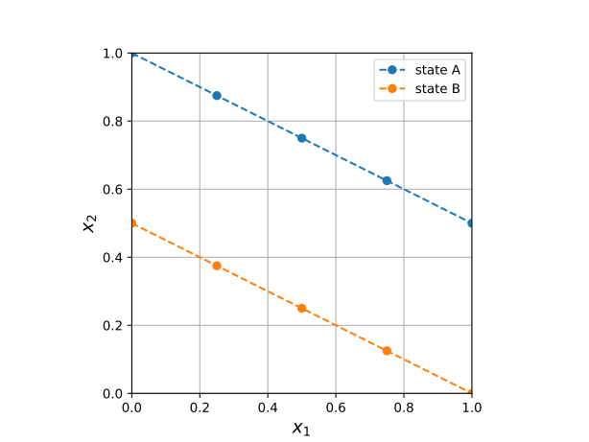
Logics of Intelligence
Step4-5-6: feature engineering, model selection, training
(in practice these are separate steps)
Let us plot the point pairs corresponding to state A and B
  the points lie in subspaces (lines)
  within state A and B
  worth to introduce new coordinates (features)

Slide 31
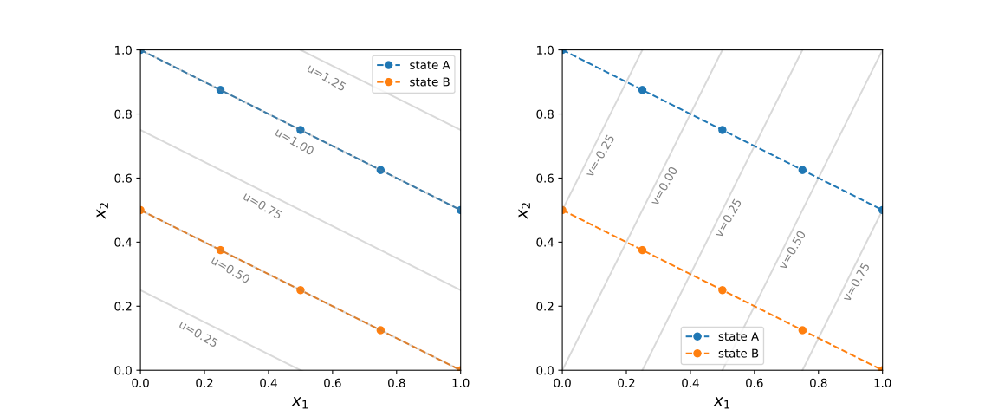
Logics of Intelligence
Step4-5-6: feature engineering, model selection, training
with the new coordinates
constant u – aligned with states; constant v – changes within a given state

Slide 32

Logics of Intelligence
Step4-5-6: feature engineering, model selection, training
To tell apart state A and B we need only the value of u!
  u = 1.0 state A
  u = 0.5 state B
  otherwise neither
solves classification task

Slide 33
Logics of Intelligence
Step4-5-6: feature engineering, model selection, training
To describe a instance belonging to a state we need just v!
  state A: v in [-0.5,0.75]
  state B: v in [-0.25,1]
solves compression,
dimensional reduction

Slide 34
Logics of Intelligence
Step4-5-6: feature engineering, model selection, training
a perfect feature selection provides a coordinate system best aligned with the equivalence classes of the data
  there are coordinates that are constant on each data class, and have different values on different classes (relevant/selective coordinates – good for classification)
  there are coordinates that change within a given data class (descriptive/irrelevant coordinates – good for compression)
task of all model building is to find (approximately) these coordinates/features

Slide 35
Logics of Intelligence
Step4-5-6: feature engineering, model selection, training
in practice we separate the task of coordination
  feature selection: original features, simple combinations
  model selection: single out a parametrizable functional space to combine the features (distance, linear- or nonlinear combinations)
  training: determine the free parameters of the model that fits the data the best

Slide 36
Logics of Intelligence
Step4-5-6: feature engineering, model selection, training
mind vs data?
  data/models importance ratio → data are central importance in real world applications
  are data enough? do we possess the necessary knowledge?
  present approach: data engineering is the most important, few fundamental research (cf. LeCun vs Wang in Meta)

Slide 37
Logics of Intelligence
Step7: evaluation
try to estimate how well the original task was solved
  class reconstruction accuracy
  robustness, proclivity for failures
  treatment of outliers
  business benefits

Slide 38
Logics of Intelligence
Step8: deployment and monitoring
in a real-life application the ML code is used as a product
requires continuous monitoring
  data/environment may change
  new classes appear
  errors may occur

Slide 39
Logics of Intelligence
takehome message: Task of the intelligence is to
find the relevant features and adapt their values to the task

Slide 40
Organizing ML projects

Slide 41
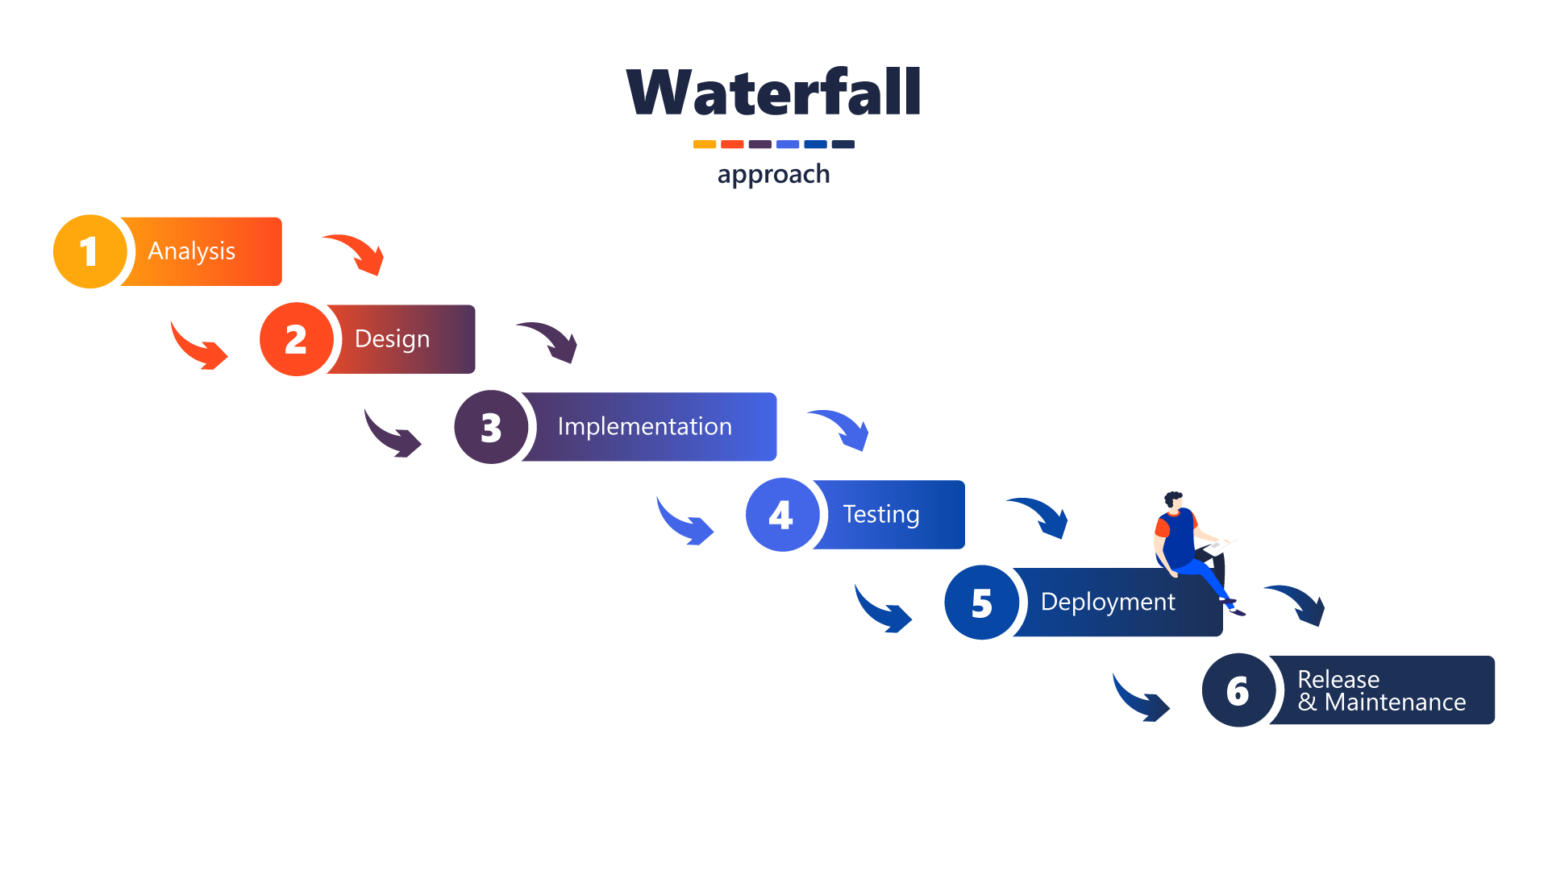
Organizing ML projects
two popular workflow schemes today: waterfall vs. agile
waterfall workflow:
  clear documentation of the task
  predictable timeline
  inflexible
  late discovery of errors
good for well-defined projects (like bridge building)

Slide 42
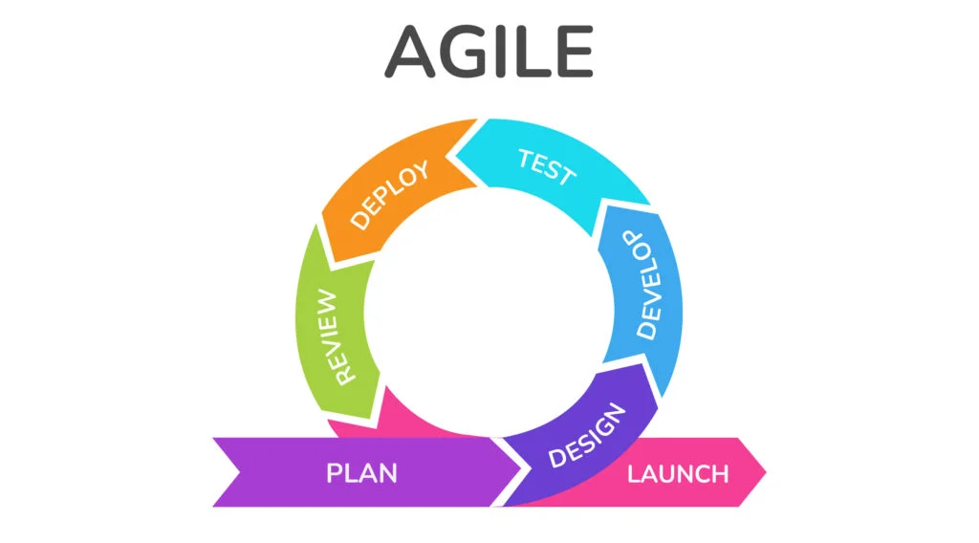


Organizing ML projects
agile workflow: (agile manifesto, description)
  individuals > processes
    collaborative vs rigid teams
  working model > detailed documentation
    Minimal Viable Product MVP
    improvement
“If you’re not embarrassed by the first version of
your product, you’ve launched too late.”
— Reid Hoffman, founder of LinkedIn
Goal: Solve transportation
MVP: Skateboard
Next: Bicycle
Then: Motorcycle
Finally: Car

Slide 43
Organizing ML projects
agile workflow: (agile manifesto, description)
  customer collaboration > contract negotiation
    customer needs even over signed contracts
  responding to change > following a plan
    original ideas/original task estimates may fail
    continuous adaptation
  launch a “good enough” product

Slide 44
Organizing ML projects
agile workflow: (agile manifesto, description)
  pros:
    flexible, self-improving, communicative
    customer-centric
  cons:
    over-emphasized meetings (“agile theater”)
    over-controlled
    less predictable

Slide 45
Organizing ML projects
agile workflow: (agile manifesto, description)
  loops, sprints
  user interface/user experience (UI/UX)
  CI/CD, CI/CD pipelines
  continuous integration, continuous deployment
  Kanban/Jira: project development visualization
  (backlog, to do, in progress, testing, done)

Slide 46
Organizing ML projects
typical small group agile project
  define the goal (user stories), create a backlog (list of tasks)
  make repo (github), branches
  make MVP, backend API, frontend, testbed
  get MVP working, deploy to test environment
  collect feedback (team + users)
  refine tasks, and directions to proceed

Slide 47
Organizing ML projects
Structure of a professional ML organization
🌐 Business side
  client/stakeholder: business requirements (e.g., “reduce equipment downtime,” “recommend better products”)
  Business Analyst / Product Manager (translates business goals into ML problems, acts as the bridge between client and technical teams)
  Project/ Product Manager (budgeting, timelines, and resource allocation, Coordinates with business analysts and technical leads to estimate cost)

Slide 48
Organizing ML projects
Production level ML organization
🧠 Data/model experts
  data engineer: build and maintain data pipelines → data collection, cleaning, validating, transformation (ETL/ELT), storing (database, data lake), monitoring
  ML engineer/data scientist
    feature generation
    design, train, and fine-tune ML models
    explores and experiments with data, build prototypes
    performance evaluation

Slide 49
Organizing ML projects
Production level ML organization
🏗️ Software & Infrastructure
  software architect: designs overall system, service planning, integration with other services, APIs, databases
  software developer (coder): implements algorithms, frontend-backend
  DevOps/MLOps engineer:
    automates deployment, monitoring, scaling of ML models
    works with Docker, Kubernetes, CI/CD pipelines, cloud platforms.
    ensures the ML system is reproducible, reliable, and easy to maintain.

Slide 50
Organizing ML projects
Production level ML organization
🛡️ Operations, Monitoring & Safety
  QA / Test Engineer: tests software and ML pipelines (unit tests, integration tests, stress tests), ensures reliability before release
  Monitoring & Reliability Engineer: monitors system health after deployment.; tracks data drift, performance degradation, unusual patterns
  Security Engineer: ensures compliance with data privacy, protects against adversarial attacks, model leaks.

Slide 51
Organizing ML projects
🎭 The Full Pipeline in a Story (user story)
Client says: “I need early warnings for dangers in a chemical plant.”
Business Analyst refines: “This means anomaly detection on sensor signals.”
Data Engineer sets up pipelines to collect sensor data.
Data Scientist explores, builds a prototype anomaly detector.
ML Engineer optimizes the model for latency and accuracy.

Slide 52
Organizing ML projects
🎭 The Full Pipeline in a Story (user story)
Software Architect decides how it fits into the production system.
Developers implement the service around the model.
DevOps/MLOps deploys it to the cloud with monitoring.
QA & Monitoring check performance and flag issues.
Security Engineer ensures compliance and robustness.

Slide 53
Programming code structure

Slide 54
Code structure
How to organize a (ML) code?
points of view:
  effective code development (also in teams)
  scalability
  extensibility
  easy maintenance

Slide 55
monolith code structure
Original approach: monolith program structure
UI, business logic, data access in one code
coding logic: input data → transformation → resulting data
best fits for imperative/procedural languages (like C, Fortran)
  program state: mutable variables
  program is a chain of commands, changing the state
natural approach → original programming style

Slide 56
monolith code structure
y = 3 #global state variable
def function(x):
x +=y
y+=1 #changes y tacitly
return x
problems:
hard to trace bugs or change code:
  variable change appear in different functions
  frequently hidden state change in procedures
  in a large code intractable structure
functions are specific → not reusable
experience: monolith codes become unmaintainable
(software complexity crisis in the 1970s–80s)
still used for starting a project (MVP)

Slide 57
programming paradigms
class MyClass:
def __init__(self, state):
self.state = state
#change of state is a class method
def rotate(self, angle):
self.state → self.state’(angle)
return self
different type of solutions:
object oriented programming
  data and the corresponding
  procedures are bundled:
  ”objects” of the world
  abstraction:
  hierarchy of classes
  inheritance: classes are reusable
  examples: C++, Java

Slide 58
programming paradigms
counter=0
def impure():
counter+=1 #side effect
return counter
def pure(x):
return x+1 #no side effect
functional programming
  stateless programs, unmutable variables
  functions give back new objects
  (pure functions)
  based on mathematical logic (λ-calculus)
  e.g. λx. x+1 and their application, e.g. (λx. x+1) 5 →6
  basic elemental functions: see next page

Slide 59
programming paradigms
basic elemental functions
  map:
  reduce/fold:
  filter:
  zip:
  compose:
examples: Haskell, Lisp, F#
not popular in the original form, but lot of elements are applied
map (λx. x*2) [1,2,3] → [2,4,6]
fold (+) 0 [1,2,3] → 6
filter even [1,2,3,4] → [2,4]
zip [‘a’,’b’,’c’] [1,2,3] → [(‘a’,1),(‘b’,2),(‘c’,3)]
(compose f g) x → f(g(x))

Slide 60
programming paradigms
mixed (multi-paradigm) languages:
  allow all kind of programming style
  examples: Python, JavaScript, Rust, Swift,
  e.g. Python has map, filter, reduce, based on lists.
  Python supports OOP, classes, inheritance, etc.

Slide 61
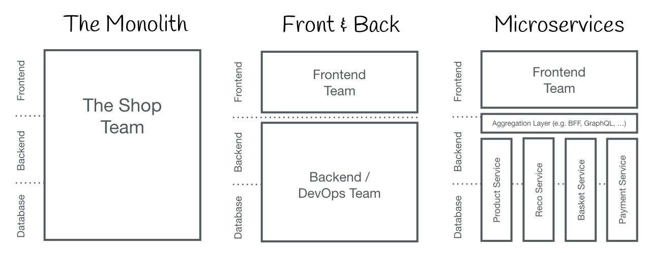
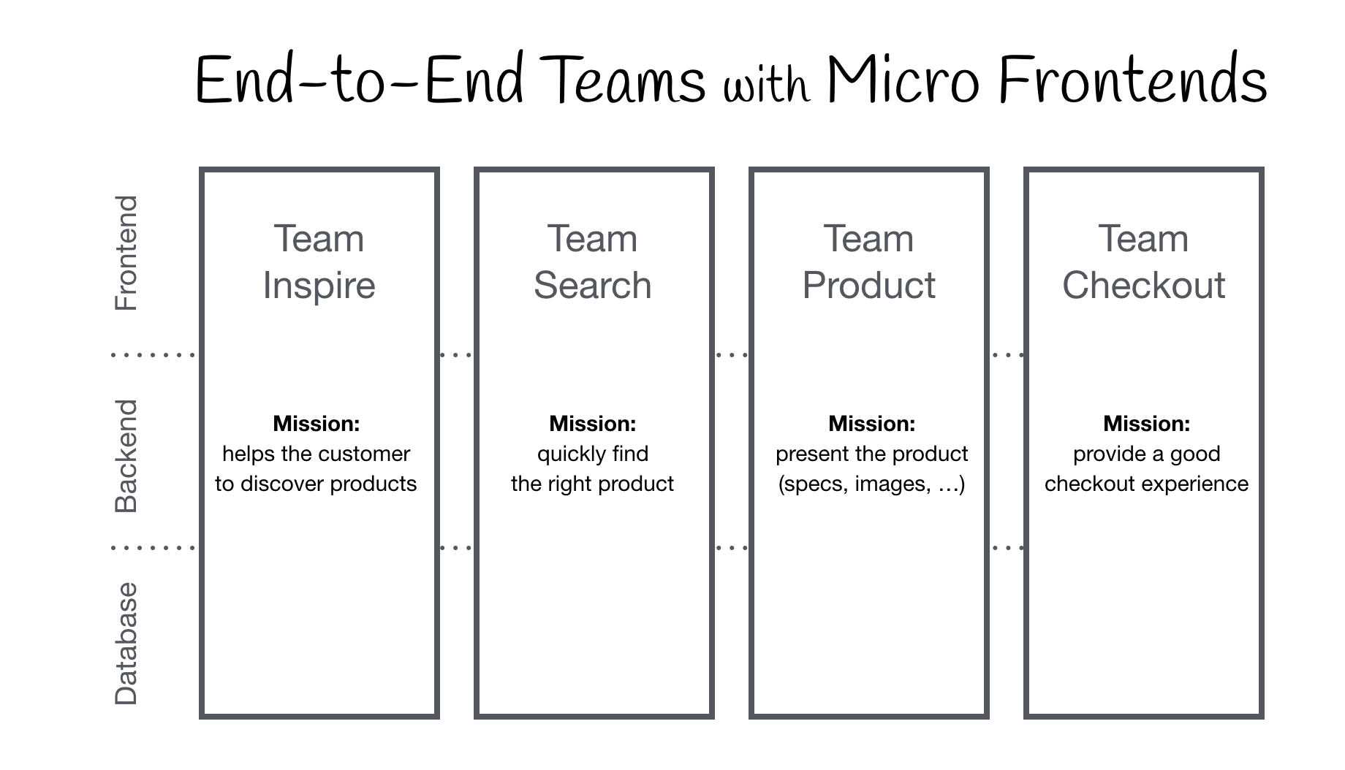
architectures
Other way of deviating from monolithic imperative coding
monolithic structure
frontend+backend
microservices
micro frontend structure
(c.f. https://micro-frontends.org/)

Slide 62
backend + frontend
Backend + frontend
rise of web (1990s) browsers became universal clients
specialized tools for browser programming
(like HTML, CSS, JavaScript)
task solving (backend) + visualization (frontend) separately
  develop separately, different languages, tools
  scale BE and FE separately
  needs interface management → see next page

Slide 63
backend + frontend
functions designed for intra-code communication, can not be applied any more
inter-service communication standards:
  APIs (application programming interface → synchronous)
  queues (message buffer → asynchronous)

Slide 64
backend + frontend
APIs – call server functions (endpoints)
  needs continuously running background processes (web server process), listening to input channels (ports)
  endpoints: well defined input and output formats, usually in json
  communication → REST API: get, put/patch, post, delete
  in Python: Flask, fastAPI
  can be asynchronous, too
#fastAPI snippet
from fastapi import FastAPI
app = FastAPI()
@app.get("/")
def read_root():
return {"message": "Hello ✨"}
-----------------------------
#start service
uvicorn main:app
-----------------------------
#call service
open http://127.0.0.1:8000, or
curl http://127.0.0.1:8000/
results {"message": "Hello ✨"}

Slide 65
backend + frontend
queues: async send message
  message broker runs in background, it stores messages
  worker processes deliver messages for subscribers/consumers
  data plain text or json
  metadata + payload
  in Python: queue + threading
#queue application example
import queue
q = queue.Queue()
#put data to queue
q.put(item)
#read data from queue
item = q.get()
#… process data ...
q.task_done()

Slide 66
microservices
Microservices + frontend
good scaling properties (e.g. web users) → requiring independence of elementary tasks became popular
lot independent, narrowly scoped (micro) services
  separate development (languages, tools, teams), deployment
  separate scaling
  resilience: bugs are confined, not affect the whole system
examples Netflix, Amazon → hype in 2010s

Slide 67
microservices
new challenge: how to organize a lot of services
microservice management:
docker, Kubernetes
#example docker-compose.yml
services:
service1:
build: ./service1
container_name: service1
ports:
- "8001:8000"
service2:
build: ./service2
container_name: service2
ports:
- "8002:8000"
-----------------------------------------------
docker-compose up --build
#example Dockerfile
FROM python:3.12-slim
WORKDIR /app
COPY main.py .
RUN pip install fastapi uvicorn
CMD ["uvicorn", "main:app", "--host", "0.0.0.0", "--port", "8000"]

Slide 68
microservices
new challenge: how to organize a lot of services
CI/CD pipelines:
  continuous improvement
  continuous deployment
  team communication
example: github

Slide 69
microservices
#example .github/workflows/ci.yml
name: CI
on:
push: branches: ["main"]
pull_request: branches: ["main"]
jobs:
build-and-test:
runs-on: ubuntu-latest
steps:
- name: Checkout code
uses: actions/checkout@v4
- name: Set up Python
uses: actions/setup-python@v5
with:
python-version: "3.12"
- name: Install dependencies
run: |
python -m pip install --upgrade pip
pip install -r requirements.txt
pip install pytest
new challenge: how to organize a lot of services
CI/CD pipelines:
  continuous improvement
  continuous deployment
  team communication
example: github

Slide 70
microservices
new challenge: how to organize a lot of services
CI/CD pipelines:
  continuous improvement
  continuous deployment
  team communication
example: github
#practical example: git clone project
git clone https://github.com/ajakovac/ML-in-Practice-I.git
cd ML-in-Practice-I

Slide 71
microservices
despite all advantages microservices have drawbacks
  operational complexity → manage hundreds of services
  network calls → latency, performance issues
  interprocess debugging is hard

Slide 72
microservices
Current trends (2020s → now)
  modular monolith applications
  microservices where they make sense
  functions-as-a-service (FaaS)
    in cloud services like AWS, Azure, Google cloud
    locally they seem like functions
    behave like services when deployed
    run on demand

Slide 73
microservices
#example in AWS
#lambda_function.py
def lambda_handler(event, context):
name = event.get("name", "my_name")
return { "statusCode": 200,
"body": f"Hello, {name}! ✨"}
-------------------------------------------
zip function.zip lambda_function.py
aws lambda create-function \
--function-name helloLambda \
--runtime python3.12 \
--role arn:aws:iam::<YOUR_ACCOUNT_ID>:role/lambda-ex-role \
--handler lambda_function.lambda_handler \
--zip-file fileb://function.zip
--------------------------------------------------
curl -X POST \
-H "Content-Type: application/json" \
-d '{"name": "MLcourse"}' \
https://abcd1234.execute-api.us-east-1.amazonaws.com/default/hello
Current trends (2020s → now)
  modular monolith applications
  microservices where they make sense
  functions-as-a-service (FaaS)
    in cloud services like AWS, Azure, Google cloud
    locally they seem like functions
    behave like services when deployed
    run on demand

Slide 74
ML Code structure
Code infrastructure → software architecture
use few necessary microservices → clear task definition
use lambda for simple services
containerize microservices → portability, environmental stability
use container management → docker (Kubernetes)
use CI/CD management → github or similar

Slide 75
Data management

Slide 76
Data management
data sources:
user input (text, image, video, etc.) – often not well formed, errors
system generated (logs, measurements, predictions) – well formed data, easy-to-use
own data, own clients (first-party), other companies, their own clients (second-party), other companies not own clients (third-party – e.g. internet usage, traffic, etc)

Slide 77
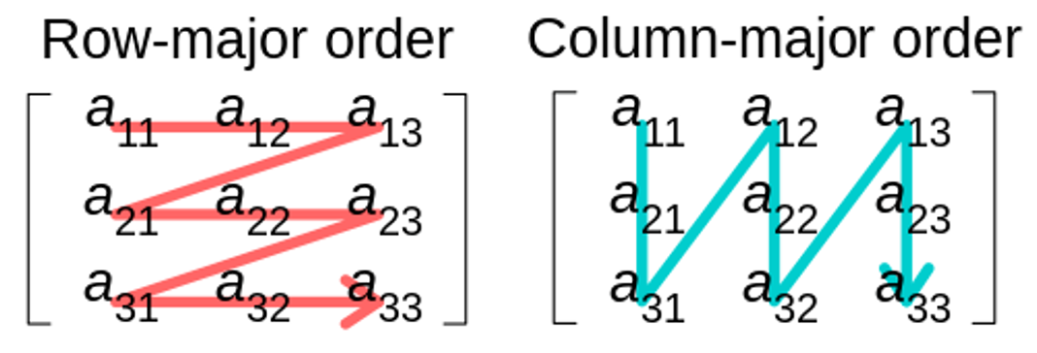
Data management
data formats
CSV (comma separated values)
  text, human readable
  tabular, row-major
  fast to get data belonging to the same example
Parquette
  binary – more compact, but not human readable
  tabular, column major
  fast to get data belonging to the same feature

Slide 78
Data management
#example books.csv
title,author,publisher,year
The Hobbit,J.R.R. Tolkien,George Allen & Unwin,1937
The Fellowship of the Ring,J.R.R. Tolkien,George Allen & Unwin,1954
Nineteen Eighty-Four,George Orwell,Secker & Warburg,1949
Brave New World,Aldous Huxley,Chatto & Windus,1932
The Catcher in the Rye,J.D. Salinger,”Little, Brown and Company”,1951
-------------------------------------------
#read data using pandas
import pandas as pd
df = pd.read_csv("books.csv")
print(df)
-------------------------------------------
#output
title author publisher year
0 The Hobbit J.R.R. Tolkien George Allen & Unwin 1937
1 The Fellowship of the Ring J.R.R. Tolkien George Allen & Unwin 1954
2 Nineteen Eighty-Four George Orwell Secker & Warburg 1949
3 Brave New World Aldous Huxley Chatto & Windus 1932
4 The Catcher in the Rye J.D. Salinger Little, Brown and Company 1951
data formats
CSV (comma separated values)
  text, human readable
  tabular, row-major
  fast to get data belonging to the same example
Parquette
  binary – more compact, but not human readable
  tabular, column major
  fast to get data belonging to the same feature

Slide 79
Data management
data formats
CSV (comma separated values)
  text, human readable
  tabular, row-major
  fast to get data belonging to the same example
Parquette
  binary – more compact, but not human readable
  tabular, column major
  fast to get data belonging to the same feature
#store in parquette – needs fastparquet to be installed
df.to_parquet("books.parquet", engine="fastparquet", index=False)
--------------------------
#store in parquette – needs fastparquet to be installed
df_parquet = pd.read_parquet("books.parquet", engine="fastparquet")

Slide 80
Data management
data formats:
JSON (JavaScript Object Notation) → today’s standard
  hierarchical structure
  text, human readable
  key-value pairs
  in Python: dict
  supported by all languages

Slide 81
Data management
#example books.json
[
{
"title": "The Hobbit",
"author": "J.R.R. Tolkien",
"publisher": "George Allen & Unwin",
"year": 1937
},
{
"title": "The Fellowship of the Ring",
"author": "J.R.R. Tolkien",
"publisher": "George Allen & Unwin",
"year": 1954
},…
]
---------------------------------------------
#read with pandas
df = pd.read_json("books.json")
data formats:
JSON (JavaScript Object Notation) → today’s standard
  hierarchical structure
  text, human readable
  key-value pairs
  in Python: dict
  supported by all languages

Slide 82
Data management
data models:
for more complicated data, and if queries are required, storing data in simple files is not enough
instead: databases with dedicated database handlers
  relational (e.g. Sqlite)
  nonrelational (e.g. Redis, Mongo)

Slide 83
Data management
data models:
relational
  tabular logic: main tables, subtables for standardization, index tables for faster query
  strict schemas
  query language for data retrieval → SQL (structured query language): declarative, specify the result, not the algorithm
  pros: simple logic, widely used
  cons: abundant schema systems, lots of superficial data, tedious to introduce new features, complicated table structure

Slide 84
Data management
#example sqlite application – built in Python package
import sqlite3
#create/connect database
conn = sqlite3.connect("Data/books.db")
cur = conn.cursor()
#create tables
cur.execute("""
CREATE TABLE IF NOT EXISTS publishers (
id INTEGER PRIMARY KEY AUTOINCREMENT,
name TEXT NOT NULL
)
""")
cur.execute("""
CREATE TABLE IF NOT EXISTS books (
id INTEGER PRIMARY KEY AUTOINCREMENT,
title TEXT NOT NULL,
author TEXT NOT NULL,
year INTEGER,
publisher_id INTEGER,
FOREIGN KEY (publisher_id) REFERENCES publishers(id)
)
""")
data models:
relational
  tabular logic: main tables, subtables for standardization, index tables for faster query
  strict schemas
  query language for data retrieval → SQL (structured query language): declarative, specify the result, not the algorithm
  pros: simple logic, widely used
  cons: abundant schema systems, lots of superficial data, tedious to introduce new features, complicated table structure

Slide 85
Data management
#insert a publisher
cur.execute("INSERT INTO publishers (name) VALUES (?)", ("George Allen & Unwin",))
publisher_id = cur.lastrowid
# Insert a book linked to that publisher
cur.execute("INSERT INTO books (title, author, year, publisher_id) VALUES (?, ?, ?, ?)",("The Hobbit", "J.R.R. Tolkien", 1937, publisher_id))
#commit changes
conn.commit()
----------------------------------------------
# Query join
cur.execute("""
SELECT b.title, b.author, p.name AS publisher
FROM books b
JOIN publishers p ON b.publisher_id = p.id
""")
print(cur.fetchall())
conn.close()
------------------------------------------------
#output
[('The Hobbit', 'J.R.R. Tolkien', 'George Allen & Unwin')]
data models:
relational
  tabular logic: main tables, subtables for standardization, index tables for faster query
  strict schemas
  query language for data retrieval → SQL (structured query language): declarative, specify the result, not the algorithm
  pros: simple logic, widely used
  cons: abundant schema systems, lots of superficial data, tedious to introduce new features, complicated table structure

Slide 86
Data management
data models:
NoSQL: no SQL → not only SQL
  pros: no schemas → flexibility, scalability, treat of unstructured data
  cons: storage capacity, performance trade-offs, data chaos
  document stores: data are stored as a JSON (string)
    query can be a more difficult task
    examples: mongoDB, CouchDB – create own index tables for effectivity
  key-value pairs: for fast query (example: RedisDB, DynamoDB)
  graph databases: concentrate on relations (nodes and edges) (Examples: Neo4j, Amazon Neptune, ArangoDB)

Slide 87
Data management
#install mongodb-image and pymongo
docker run -d --name mongodb -p 27017:27017 -v ~/my_data/mongo:/data/db mongo:7.0
pip install pymongo
-------------------------------------
#runs a service in the background – start/stop it
docker start/stop mongodb
--------------------
#install mongodb and pymongo
from pymongo import MongoClient
# 1. Connect to local MongoDB
client = MongoClient("mongodb://localhost:27017/")
# 2. Create (or use existing) database
db = client["library"]
# 3. Create collections
publishers = db["publishers"]
books = db["books"]
# 4. Clear old data (for demo purposes)
publishers.delete_many({})
books.delete_many({})
data models:
NoSQL: no SQL → not only SQL
  pros: no schemas → flexibility, scalability, treat of unstructured data
  cons: storage capacity, performance trade-offs, data chaos
  document stores: data are stored as a JSON (string)
    query can be a more difficult task
    examples: mongoDB, CouchDB
  key-value pairs: for fast query (example: RedisDB, DynamoDB)
  graph databases: concentrate on relations (nodes and edges) (Examples: Neo4j, Amazon Neptune, ArangoDB)

Slide 88
Data management
# 5. Insert publishers
pub_allen = publishers.insert_one({"name": "George Allen & Unwin"}).inserted_id
pub_secker = publishers.insert_one({"name": "Secker & Warburg"}).inserted_id
pub_chatto = publishers.insert_one({"name": "Chatto & Windus"}).inserted_id
pub_little = publishers.insert_one({"name": "Little, Brown and Company"}).inserted_id
# 6. Insert books with publisher references
books.insert_many([
{"title": "The Hobbit", "author": "J.R.R. Tolkien", "year": 1937, "publisher_id": pub_allen},
{"title": "The Fellowship of the Ring", "author": "J.R.R. Tolkien", "year": 1954, "publisher_id": pub_allen},
{"title": "Nineteen Eighty-Four", "author": "George Orwell", "year": 1949, "publisher_id": pub_secker},
{"title": "Brave New World", "author": "Aldous Huxley", "year": 1932, "publisher_id": pub_chatto},
{"title": "The Catcher in the Rye", "author": "J.D. Salinger", "year": 1951, "publisher_id": pub_little},
])
# 7. Query: find all books and join publisher info manually
for book in books.find():
publisher = publishers.find_one({"_id": book["publisher_id"]})
print(f"{book['title']} by {book['author']} "
f"was published by {publisher['name']} in {book['year']}.")
data models:
NoSQL: no SQL → not only SQL
  pros: no schemas → flexibility, scalability, treat of unstructured data
  cons: storage capacity, performance trade-offs, data chaos
  document stores: data are stored as a JSON (string)
    query can be a more difficult task
    examples: mongoDB, CouchDB
  key-value pairs: for fast query (example: RedisDB, DynamoDB)
  graph databases: concentrate on relations (nodes and edges) (Examples: Neo4j, Amazon Neptune, ArangoDB)

Slide 89
Data management
data storage:
data warehouse:
  stores historical data → structured, cleaned, integrated
  optimized for analysis, reporting → few but very large, complex queries
  ETL (extract, transform, load)
  OLAP (online analytic processing)
  examples: historical sales data, stock price data
  solutions: Amazon Redshift, Google BigQuery

Slide 90
Data management
data storage:
database:
  stores current, operational data.
  used for day-to-day transactions (insert, update, delete).
  optimized for fast read/write, many small simple queries
  example: an e-commerce database storing users, orders, payments
  OLTP (Online Transaction Processing)
  solutions: MySQL, PostgreSQL, Oracle DB, MongoDB, DynamoDB

Slide 91
Data management
data storage:
data lake:
  stores data in raw form → future-proof
  application goal not needed to be specify
  cheap and scalable storage (HDFS, Amazon S3, Azure Data Lake Storage, Google Cloud Storage)
  schema-on-read solutions (ELT, extract, load, transform) → processing engines (Kafka, TensorFlow, Athena)
  example: log storage, IoT data storage

Slide 92
Data management
data sampling: collecting all data usually not feasible
nonprobability sampling → focus on data collection; prone to selection bias
  convenience sampling: take all what is available
  snowball sampling: start with a small set, and follow its descendants
  judgement sampling: experts say what to collect
  quota sampling: collect the same number of data from different areas (like age groups)
  example of bias: psychology experiments (university students), sentiment analysis (wordy people), medical data (unsuccessful treatments)

Slide 93
Data management
data sampling:
probability sampling → needs a data model → biased?
  stratified sampling: collect the same amount of data per class
  weighted sampling: take into account data scaled with probability
    in choice: class A 25%, class B 75% → consider A samples 3 times
    in training: give weight for underrepresented classes (see later)
  reservoir sampling: keep the first k sample, and replace it randomly
  importance sampling

Slide 94
Data management
data augmentation:
if there are not enough data, or not representative enough, we can transform data to generate new ones (symmetries)
  rotation, scaling
  perturbation, noising
  texture or style change
data generation: simulations in artificial environment (e.g. self-driving cars)

Slide 95
Data management
labelling:
for classification we should collect examples in different classes
problems:
  how unambiguous are the labels? → multi-label classes
  how precise are the labels? → no database is 100% correct!
  what to do with missing labels? → label functions, semi-supervised, etc.
hand labelled data, naturally labelled data (context is given), automatically generated data

Slide 96
Monitoring and evaluation

Slide 97
Monitoring and evaluation
How can we assess the success of the ML results?
not unique! depends on the problem on hand
  example: percentage of correctly classified images
  if the probability of belonging to class A is 99%, then the simple method saying that all elements belong to A is 99% accurate!
  clearly not good, if the task is to find the 1% not-A class!

Slide 98
Monitoring and evaluation
baselines: how accurate are simple methods and other approaches?
  random baseline: choose class randomly → 1/N probability for balanced
  zero rule: all belonging to one class → high probability for inbalanced
  simple heuristic → use a simple proxy (feature)
  human experts → how well do humans perform?
  other ML methods

Slide 99
Monitoring and evaluation
confusion matrix
  correct classes vs. estimated classes
  works for multi-class evaluation
  in probabilistic sense joint probability:
 | Actual Yes | Actual No | Predicted Total
Predicted Yes | TP=0.510 | FP=0.038 | PP=0.548
Predicted No | FN=0.032 | TN=0.420 | PN=0.452
Actual Total | AP=0.542 | AN=0.478 | 1.0

Slide 100
Monitoring and evaluation
correctness measures for 2-class evaluation
  accuracy: prob. of choosing the correct class: (TP+TN)
  precision: conditional for Predicted Yes:
  recall: conditional for Actual Yes:
  type I error: probability of false alarm:
  type II error: probability of missing signal:

Slide 101
Monitoring and evaluation
controlled case → measure does not matter
  probability of class A or B is 50%, predict symmetrically
  accuracy=98%
  for class A: precision=98%, recall=98%, type II error=2%
  for class B: precision=98%, recall=98%, type I error=2%
 | Actual Yes | Actual No | Predicted Total
Predicted Yes | TP=0.49 | FP=0.01 | PP=0.5
Predicted No | FN=0.01 | TN=0.49 | PN=0.5
Actual Total | AP=0.5 | AN=0.5 | 1.0

Slide 102
Monitoring and evaluation
extreme cases
  classify everything as class A, but probability of class A is 99%
  accuracy=99%
  for class A: precision=99%, recall=100%, type II error=0%
  for class B: precision=?, recall=0%, type I error=100%
 | Actual Yes | Actual No | Predicted Total
Predicted Yes | TP=0.99 | FP=0.01 | PP=1.0
Predicted No | FN=0.0 | TN=0.0 | PN=0.0
Actual Total | AP=0.99 | AN=0.01 | 1.0

Slide 103
Monitoring and evaluation
extreme cases
  classify everything randomly, but probability of class A is 98%
  accuracy=50%
  for class A: precision=98%, recall=50%, type II error=50%
  for class B: precision=2%, recall=50%, type I error=50%
 | Actual Yes | Actual No | Predicted Total
Predicted Yes | TP=0.49 | FP=0.01 | PP=0.5
Predicted No | FN=0.49 | TN=0.01 | PN=0.5
Actual Total | AP=0.98 | AN=0.02 | 1.0

Slide 104
Monitoring and evaluation
effect of a threshold on the prediction
  in lot of cases Yes/No decision comes from comparing a signal with a threshold → e.g. smoke detector signal vs. danger level
  ROC (receiver operating characteristics)
    recall vs. type I error
    correct alarm probability vs. false alarm probability
  AUC: area under curve

Slide 105
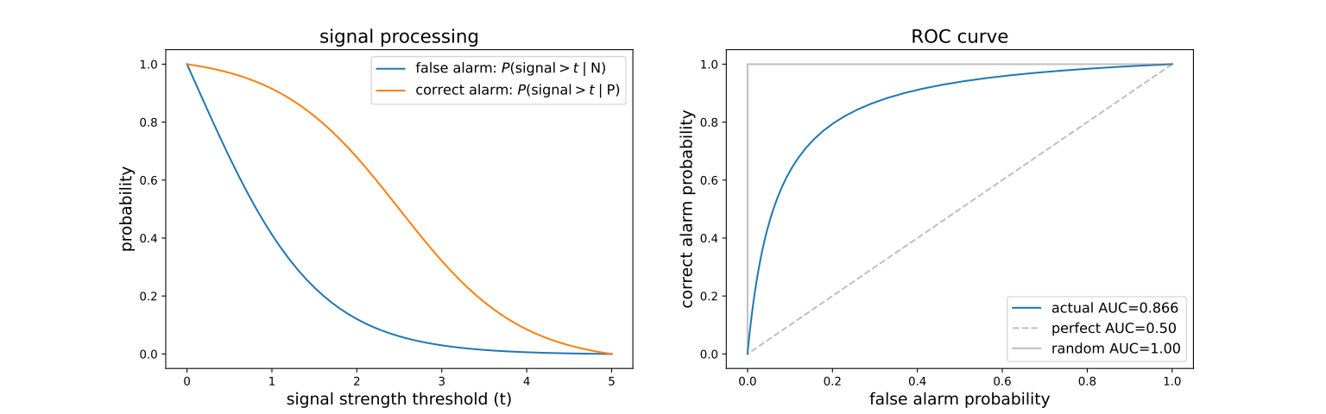
Monitoring and evaluation
effect of a threshold on the prediction

Slide 106
Data modelling

Slide 107
Data modelling
task: find out the selective/descriptive features
depends both on the dataset and the context
selective: constant on a class, descriptive: changes within a class
class depends on the context
finding the selective coordinates is the main challenge
we start with simple 1D classification problems, and generalize to several dimensions

Slide 108
One dimensional dataset classification

Slide 109
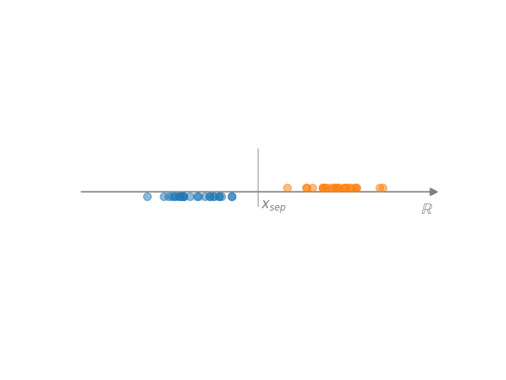
One dimensional dataset
Simplest basic case: characterization of one-dimensional data
  data → (numbers for analytic characterization)
Separation of two 1D sets
  assume that in given sections belong (approximately) to a single class
  basic case: one section → A, other section → B
  if the two sets are separated (hard margin)
  overlapping case? → no perfect solution

Slide 110
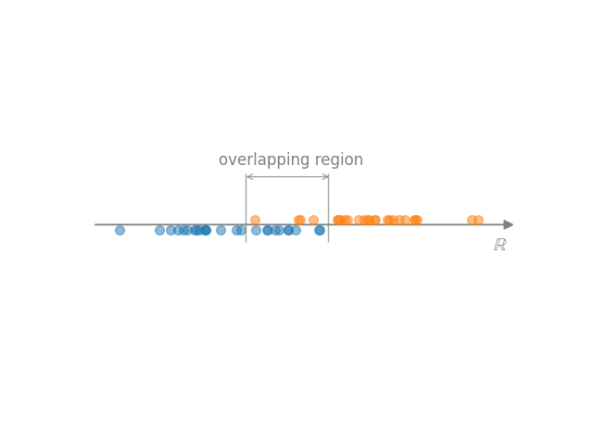
One dimensional dataset
overlapping regions → no perfect solution (heuristics)
  choose somewhere in the
  overlapping region (eg. midpoint)
  define en error function in the overlapping region, e.g.
  p=1 (“hinge loss”) → median, p=2 → mean
  we can weight the points

Slide 111
One dimensional dataset
Another approach: treat the problem as a regression
  define a function
  a classification can always be translated to regression
  simplest: linear relation f(x)=ax+b
  probabilistic interpretation:
  logistic map, probability of belonging to class B
  loss function:

Slide 112
One dimensional dataset
# Python function minimization
import numpy, matplotlib
def P(p, x):
a,x0=p
return np.exp(a*(x-x0))/(1+np.exp(a*(x-x0)))
def loss(p, A, B):
loss = np.sum([P(p,a)**2 for a in A])
loss += np.sum([(P(p,b)-1)**2 for b in B])
return loss
p0 = [1, 1] # initial guess
params = (A,B) # values of a, b
res = minimize(loss, p0, args=params)
a,x0 = res.x
Another approach: treat the problem as a regression
  define a function
  a classification can always be translated to regression
  simplest: linear relation f(x)=ax+b
  probabilistic interpretation:
  logistic map, probability of belonging to class B
  loss function:

Slide 113
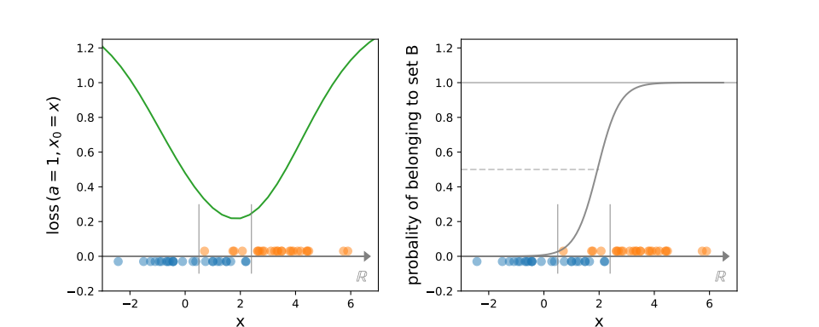
One dimensional dataset
Another approach: treat the problem as a regression
  logistic map, probability of belonging to class B

Slide 114
Probability and information theory basics

Slide 115
Information theory basics
Practical probability theory (adapted to ML):
possible outputs of an event: sample space
features (→ random variables): functions,
observe a list of events:
probability: → histogram
distribution:
probability density:

Slide 116
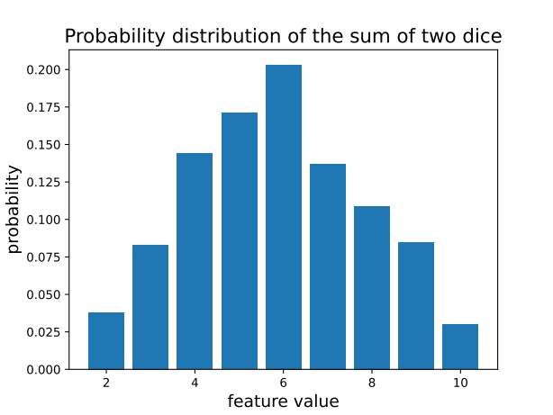
Information theory basics
example of 2 dice thrown N times
# generate data
Ndata = 1000
data = np.random.randint(1,6,size=(Ndata,2))
feature = data[:,0] + data[:,1]
# measure histogram
fmax = int(max(feature))
fmin = int(min(feature))
bins = np.zeros(fmax-fmin+1)
for f in feature:
bins[int(f-fmin)] += 1
bins/=Ndata
# show result
fig,ax = plt.subplots()
ax.bar(np.arange(fmin,fmax+1),bins)
ax.set_xlabel('feature value', fontsize=14)
ax.set_ylabel('probability', fontsize=14)

Slide 117
Information theory basics
Joint probability distributions
the features can have several components →
their distribution is called joint probability distribution:
if we are interested only on one component:
for independent features the value of x does not depend on the value of y

Slide 118
Information theory basics
Information theory: statistical relation of measurements
assume we have measured a lot N→∞
allows simplifications → Stirling formula:
measure of the uncertainty / unpredictability / impurity of a probability distribution → Shannon entropy

Slide 119
Information theory basics
Shannon entropy: measure of variability of a distribution
perform N measurements with n possible outputs (bins)
count the number of results in each bin:
how many realizations is possible for a given ?
Shannon entropy: log of this number over N
equivalent to the entropy concept in physics: number of microstate representation of a macrostate

Slide 120
Information theory basics
Shannon entropy:
take n bins, N independent measurements
we obtain → probability
how many ways can this distribution be realized?
(measurements within a bin are indistinguishable)
binomial – multinomial expression

Slide 121
Information theory basics
Shannon entropy:
information theory: → for all parts
Stirling formula, using
Shannon entropy:

Slide 122
Information theory basics
Shannon entropy:
always positive or zero
minimal for a pure sample
maximal for uniform sample
convex

Slide 123
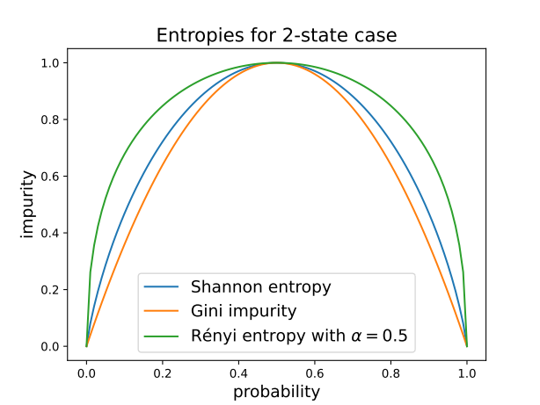
Information theory basics
Other entropy formulae:
we assumed independence of measurement bins
what if they are not (non-additive systems)
general definition using properties
(positive, convex)
examples:
  Rényi-Tsallis entropy
  Gini impurity

Slide 124
Information theory basics
Shannon entropy and amount of information
we have n events with probabilities
define information as the minimal number of questions needed to find out which one happened? → twenty questions game
answer: Shannon entropy!
  one question → one “bit” of information
  Shannon entropy = information content
  for uniform probabilities logarithmic search, in general Huffmann coding

Slide 125
Information theory basics
Shannon entropy and amount of information – technical slide
coding: a binary code corresponds an interval in [0,1)
can be placed non-overlapping if (Kraft–McMillan theorem)
choose code lengths → non-overlapping
average code length

Slide 126
Information theory basics
Shannon entropy and amount of information
example for Huffmann coding
average questions:
0.4+3x0.6=2.2
Shannon entropy:
2.12

Slide 127
Information theory basics
Joint probability, entropy and mutual information
if states depend on two variables, the joint probability
for independent variables
the corresponding Shannon entropy
measure of independence: mutual information

Slide 128
Information theory basics
Joint probability, entropy and mutual information
example: 2 bits
# Shannon entropy function
def SH(p):
return -p*np.log2(p+1e-10)
pX = np.sum(p0, axis=1)
pY = np.sum(p0, axis=0)
pXY = np.reshape(p0, -1)
allH = []
for p in [pXY,pX,pY]:
H = 0
for pi in np.reshape(p, -1):
H += SH(pi)
allH.append(H)
IXY = allH[1] + allH[2] - allH[0]

Slide 129
Information theory basics
Joint probability, entropy and mutual information
example: 2 bits
# example: independent case
p0=[[ ¼, ¼ ], [¼, ¼]]
pX = [½, ½]
pY = [½, ½]
# note that pXY = pX*pY
HX = 1
HY = 1
HXY = 2
IXY = 0
# Shannon entropy function
def SH(p):
return -p*np.log2(p+1e-10)
pX = np.sum(p0, axis=1)
pY = np.sum(p0, axis=0)
pXY = np.reshape(p0, -1)
allH = []
for p in [pXY,pX,pY]:
H = 0
for pi in np.reshape(p, -1):
H += SH(pi)
allH.append(H)
IXY = allH[1] + allH[2] - allH[0]

Slide 130
Information theory basics
Joint probability, entropy and mutual information
example: 2 bits
# example: independent case
p0=[[ ¼, ¼ ], [¼, ¼]]
pX = [½, ½]
pY = [½, ½]
# note that pXY = pX*pY
HX = 1
HY = 1
HXY = 2
IXY = 0
# Shannon entropy function
def SH(p):
return -p*np.log2(p+1e-10)
pX = np.sum(p0, axis=1)
pY = np.sum(p0, axis=0)
pXY = np.reshape(p0, -1)
allH = []
for p in [pXY,pX,pY]:
H = 0
for pi in np.reshape(p, -1):
H += SH(pi)
allH.append(H)
IXY = allH[1] + allH[2] - allH[0]
# example: not independent case
p0=[[ 1/3, 1/6 ], [¼, ¼]]
pX = [½, ½]
pY = [7/12, 5/12]
# note that pXY not = pX*pY
HX = 1
HY = 0.98
HXY = 1.96
IXY = 0.02

Slide 131
Information theory basics
Probability of the observed sample
we randomly choose case i with probability
what is the probability that we observe events from class i?
logic of the result:
  first we choose event 1, next event 2, etc. →
  number of such events is
  probability

Slide 132
Information theory basics
Probability of the observed sample
logarithm of the result in the N→∞ case
Kullback-Leibler divergence:
interpretation: “distance” of probability distributions

Slide 133
Decision trees, ensemble improvements,
K-nearest neighbour (KNN) method

Slide 134
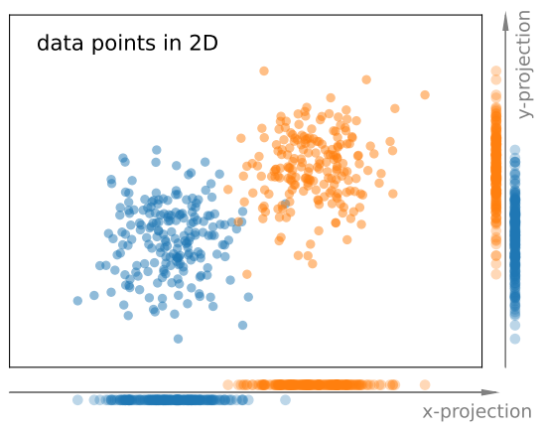
Tree based methods
The generalization to multiple dimensions is not simple
  in 1D the coordinates are unique
  in multidimensional case we can optimize the coordination → features
  simplest case: use original coordinates
  usually the original coordinates are not
  equally useful
  (c.f. image → x coord separates more)
  choose that coordinate that leads to the
  smallest total impurity!

Slide 135
Tree based methods
Decision tree (DT)
always converges, but may result in fragmented divisions
set 1
divide it into two along the coordinate where the
total impurity is smallest
start from an impure set
set 2
repeat until pure or max number

Slide 136
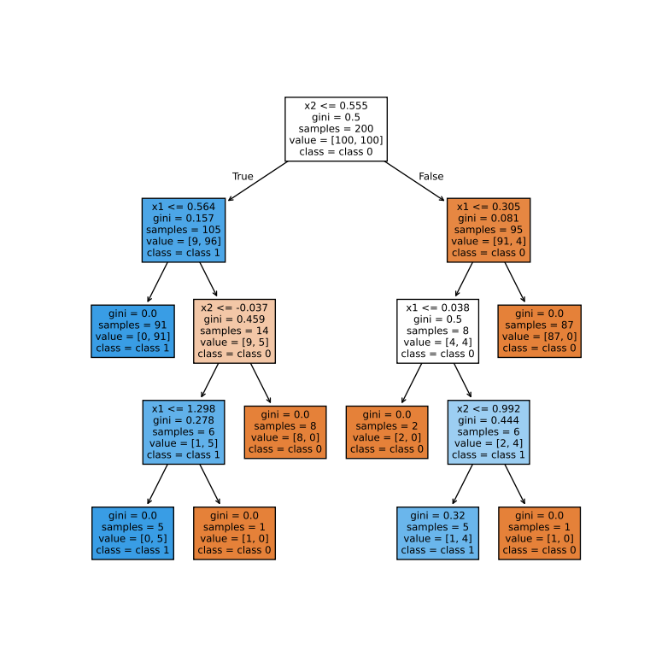
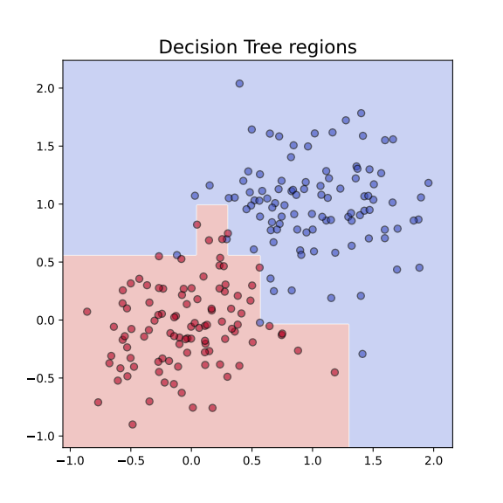
Tree based methods
Decision tree (DT) example
  two 2D sets
pros:
  simple
  interpretable
cons:
  not robust enough
  (→ irregular shape)

Slide 137
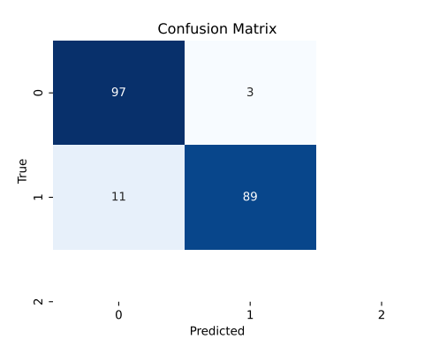
Tree based methods
Decision tree (DT) example
  two 2D sets
pros:
  simple
  interpretable
cons:
  not robust enough
  (→ irregular shape)
  use fixed depth!
  accuracy: train: 100%, test: 92.5%

Slide 138
Tree based methods
Decision tree (DT) technical solution in Python → github
# Decision Tree example
from sklearn.tree import DecisionTreeClassifier
from sklearn.metrics import confusion_matrix
# 1. get or generate data and labels
# 2. Fit a decision tree
clf = DecisionTreeClassifier()
clf.fit(data, labels)
# 3. use for prediction
pred_labels = clf.predict(other_data)
#4. confusion matrix
cm = confusion_matrix(labels, pred_labels)

Slide 139
Ensemble methods

Slide 140
Ensemble methods
Decision tree → too specific for a sample
Possible solution: use ensemble of methods
ways of improvement
  bagging (Bootstrap AGGregatING) → bagging, random forest
  boosting → adaptive boosting, gradient boosting
  other methods → extra trees, isolated forests, oblique trees

Slide 141
Bagging
Idea:
  train several models in slightly different datasets
  each dataset contains the same number of data from the database, but some of them are missing, some appear multiple times
  combine the results → regression: average, classification: majority vote
Benefits:
  lowers variance
  increases robustness

Slide 142
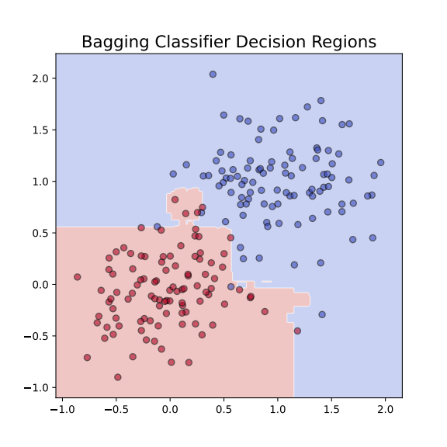
Bagging
# Bagging example
from sklearn.ensemble import BaggingClassifier
from sklearn.tree import DecisionTreeClassifier
from sklearn.metrics import confusion_matrix
# bagging based on decision tree
base_tree = DecisionTreeClassifier()
clf = BaggingClassifier(
estimator=base_tree,
n_estimators=50, # number of trees
max_samples=0.8, # each tree sees 80% of data
bootstrap=True, # sampling with replacement
random_state=42
)
clf.fit(X,y)
# 3. use for prediction
pred_labels = clf.predict(other_data)
#4. confusion matrix
cm = confusion_matrix(labels, pred_labels)
Code: github

Slide 143
Random forest
Idea: in addition vary the used parameters, too
  train several models in slightly different datasets
  each model uses selected data and selected parameters
  combine the results → regression: average, classification: majority vote
Benefits:
  more robust than simple bagging
  can be used to rank parameters by their significance, i.e. which contributed more to the final decision

Slide 144

Random forest
# Random Forest example
from sklearn.ensemble import RandomForestClassifier
from sklearn.metrics import confusion_matrix
# bagging based on decision tree
# Train Random Forest
clf = RandomForestClassifier(
n_estimators=100, # number of trees
max_depth=None, # let trees grow fully
random_state=42 # random generator seed
)
clf.fit(X, y)
# 3. use for prediction
pred_labels = clf.predict(other_data)
#4. confusion matrix
cm = confusion_matrix(labels, pred_labels)
2D case
accuracy: 94%

Slide 145
Boosting
Idea:
  calculate a series of decision trees
  each focuses on the points where the previous one fails
  combine weighted sum of all of these models
Adaptations: AdaBoost, Gradient Boosting (GBM), XGBoost, …

Slide 146

Boosting
# AdaBoost example
from sklearn.metrics import confusion_matrix
from sklearn.ensemble import AdaBoostClassifier
# boosting based on decision tree
# Train AdaBoost model
boost = AdaBoostClassifier(
estimator=DecisionTreeClassifier(max_depth=2),
n_estimators=50,
learning_rate=1.0,
random_state=42)
boost.fit(X, y)
# 3. use for prediction
pred_labels = boost.predict(other_data)
#4. confusion matrix
cm = confusion_matrix(labels, pred_labels)
2D case
accuracy: 94%

Slide 147
k-nearest neighbour (KNN) model

Slide 148
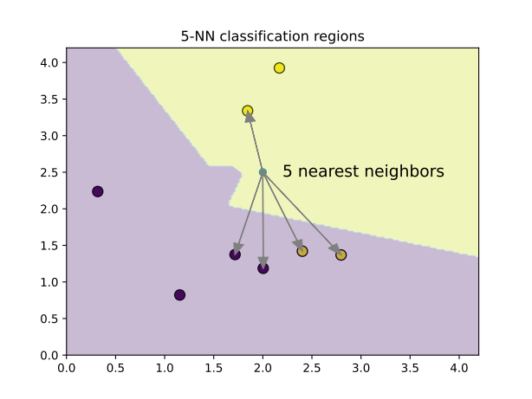
KNN
a different idea: similar points are close in the feature space
for a good guess on the class peek the neighbouring points
algorithm:
  keep all points in the training set
  new point: compute all the distances
  → needs a distance measure
  keep first k closest points
  estimated class: majority vote

Slide 149
KNN
✅ pros
  simple, intuitive, no training phase
  naturally handles multi-class problems
❌ cons:
  slow at prediction time (needs to compare with all samples)
  sensitive to irrelevant features and scaling (c.f. distance measure)
  struggles in high dimensions (“curse of dimensionality”)

Slide 150
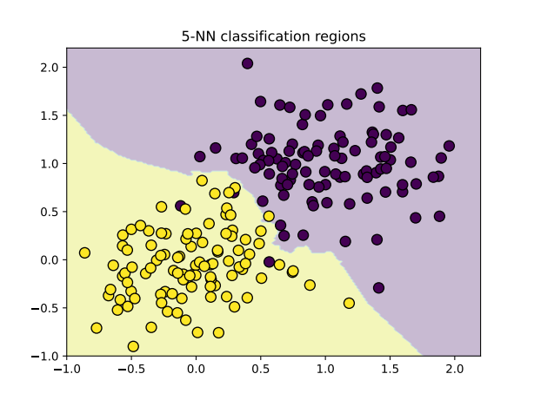
KNN
# Random Forest example
from sklearn import svm
from sklearn.neighbors import KNeighborsClassifier
# Train a 3-NN classifier
knn = KneighborsClassifier(n_neighbors=5)
knn.fit(X,y)
# Predict on the test set
y_pred = knn.predict(X_test)
# Evaluate
acc = accuracy_score(y_test, y_pred)
→ acc = 97.5%
in code

Slide 151
Estimate relevance of features

Slide 152
Relevance of features
not all features contribute equally to the result – to reduce the number of features we shall asses their relevance
idea: measure the change in the result when change the feature
relevance measures (the most used ones)
  feature importance (only for random forest)
  permutation importance, feature masking
  mutual information
  in deep neural networks Gradient-weighted Class Activation Mapping (Grad-CAM)

Slide 153
Relevance of features
we will demonstrate the feature relevance measures in a 2-class 20 dimensional dataset with 2000 elements
# make mulitdimensional dataset
from sklearn.datasets import make_classification
from sklearn.model_selection import train_test_split
ndim = 20
Nsamples = 2000
X, y = make_classification(n_samples=Nsamples, n_features=20, n_classes=2, random_state=42)
X_train, X_test, y_train, y_test = train_test_split(X, y, test_size=0.2, random_state=42)

Slide 154
Feature importance
works only for random forest
idea:
  measure the impurity (e.g. Gini impurity) of all nodes before and after a decision
  if we use a feature for a decision, measure the impurity decrease
  average over the forest

Slide 155
Feature importance
example: create a 20 dimensional dataset with 2000 elements
train a random forest classifier
# make mulitdimensional dataset
from sklearn.ensemble import RandomForestClassifier
# Creating a Random Forest classifier
clf = RandomForestClassifier(n_estimators=100, random_state=42)
# Training the classifier on the training data
clf.fit(X_train, y_train)

Slide 156
Feature importance
example: create a 20 dimensional dataset with 2000 elements
train a random forest classifier
evaluate the result
# evaluate result
from sklearn.metrics import confusion_matrix
# Making predictions on the testing data
y_pred = clf.predict(X_test)
# confusion matrix
cm = confusion_matrix(y_test, y_pred)
accuracy = np.trace(cm) / np.sum(cm)
→ accuracy = 93.5%

Slide 157
Feature importance
example: create a 20 dimensional dataset with 2000 elements
train a random forest classifier
evaluate the result
get feature importance
feature_importance =clf.feature_importances_
→np.array([0.01291599, 0.27999269, 0.01658218, 0.01157727, 0.15054909, 0.01555601, 0.0150478 , 0.01637177, 0.01582075, 0.27170634, 0.01723006, 0.01812296, 0.01401398, 0.01165928, 0.01404261, 0.01398676, 0.01323008, 0.0636087 , 0.01551626, 0.01246943])

Slide 158
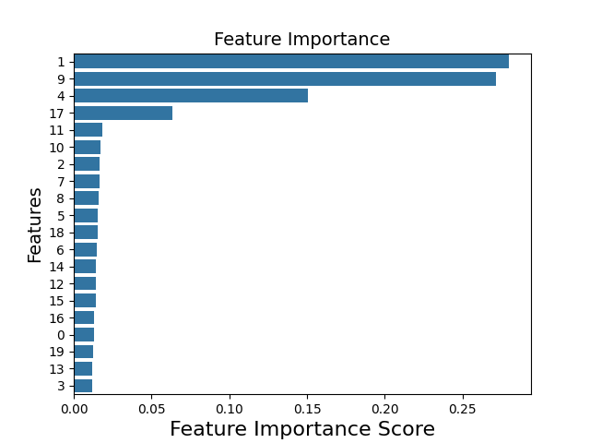
Feature importance
example: create a 20 dimensional dataset with 2000 elements
train a random forest classifier
evaluate the result
get feature importance
visualize it
sorted_idx = np.argsort(feature_importance)[::-1]
plt.figure()
sns.barplot(
x=feature_importance[sorted_idx],
y=np.arange(len(sorted_idx)),
orient='h')
plt.yticks(np.arange(len(sorted_idx)),sorted_idx)

Slide 159
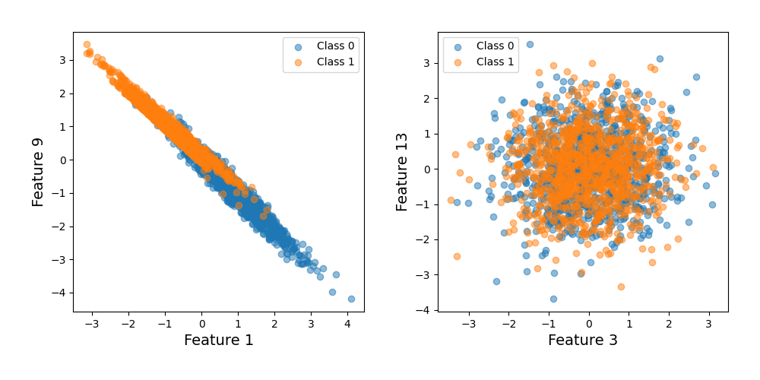
Feature importance
example: create a 20 dimensional dataset with 2000 elements
most (1,9) and least (13,3) important features

Slide 160
Permutation importance
works for all methods
idea:
  train the model, measure the performance – baseline
  for each feature permute the values among samples
  measure the performance again
  relevance of the feature: drop in performance
  instead permutation we can use a constant value (e.g. average), or a random value → mask that feature

Slide 161
Permutation importance
get permutation importance in Pyhton
# import package
from sklearn.inspection import permutation_importance
# use trained model clf to calculate importance
result = permutation_importance(clf, X_test, y_test, n_repeats=10, random_state=42)
# read mean and variance of the estimates
importances = result.importances_mean
std = result.importances_std

Slide 162
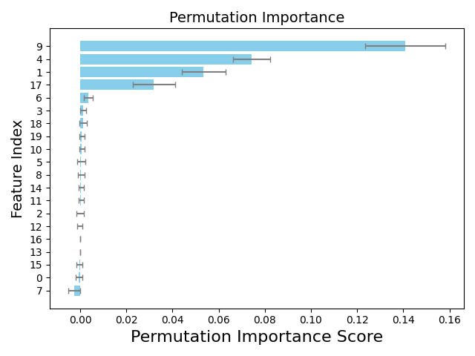
Permutation importance
get permutation importance in Pyhton
visualize the result
same features are selected as
before, but order is different

Slide 163
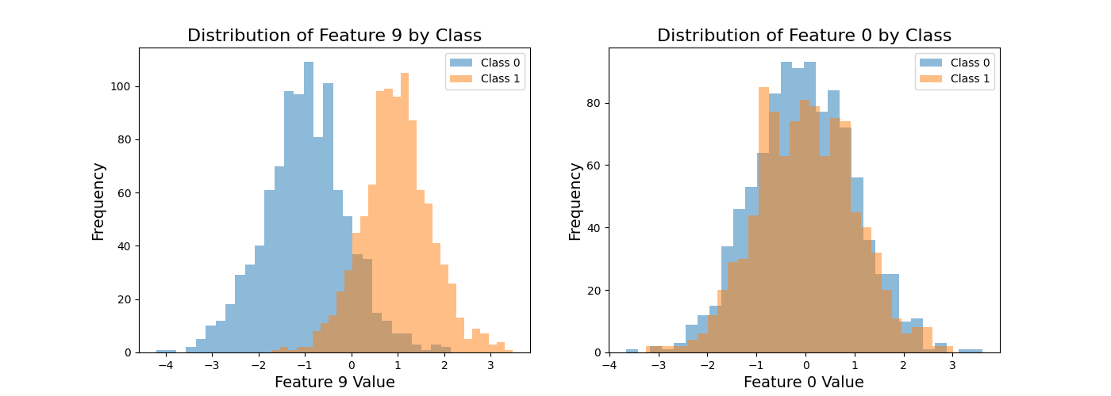
Permutation importance
choose feature 9, and feature 0 to demonstrate the effect
plot the distribution of the given feature, conditioned for the class (histogram)

Slide 164
Mutual information
can be used for any models – for any two set, actually
idea:
  calculate the joint probability of two sets
  if x and y are independent, then the joint probability is the product
  measure the dependence (mutual information) by
  can be used to measure mutual information between features and labels
independent

Slide 165
Mutual information
in Python there is a package to calculate mutual information
the code
# import package
from sklearn.feature_selection import mutual_info_classif, mutual_info_regression
# we can use the original labels, or the model-predicted ones
# characteristic for both the system and the trained model
# y = clf.predict(X)
mi_model = mutual_info_classif(X, y, random_state=42)
mi_model /= np.sum(mi_model)

Slide 166
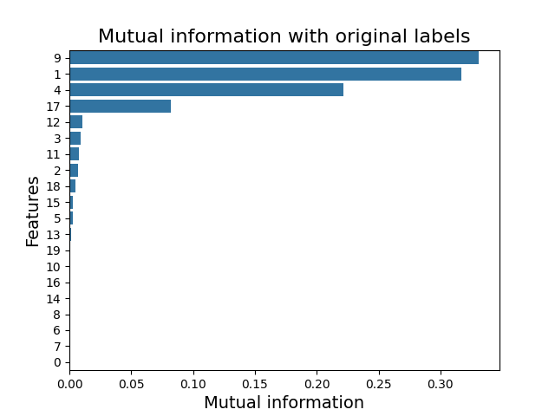
Mutual information
in Python there is a package to calculate mutual information
the code
visualization
similar result as before

Slide 167
Regression

Slide 168
Regression
Regression is optimization in a continuous parameter space
Data model → feature optimization:
  we need a parametric combination of the original variables
  optimize with respect to some condition (c.f. SVM)
Continuous value estimation:
  the task can be to predict a continuous variable
  classification can be based on probability distribution

Slide 169
Regression
task of regression
we have data pairs (X, Y) → database
we are looking for a model that
  we can not consider all possible functions (too large space)
  fix a functional space (e.g. polynomials, Gaussians, etc.):
  the variables omega select the actual function

Slide 170
Regression
task of regression
there is no perfect model! → philosophical problem …
  not enough observation (data)
  data do not contain all information
  functional space does not cover all possible effects
consequence: can not be satisfied
what can be achieved: best representation, where the error is the smallest → what is “best”, and what is “error”?

Slide 171
Regression
task of regression – theoretical approach
not enough information: x→y relation is not unique
there is a probability to measure a (data, label) pair:
for the complete dataset, assuming independent measurements
for a given input there can be a lot of outputs: conditional probability (instead of a function)

Slide 172
Regression
task of regression – theoretical approach
data model:
what is the best parameter choice? → ensemble of worlds
define the “distribution of the parameters” using Bayes theorem
as the function of the parameter → likelihood function
(assuming no restriction to possible parameter values)

Slide 173
Regression
task of regression – theoretical approach
best parameter value when is maximal (maximum likelihood):
confidence levels: → hypersurfaces
a confidence level can be characterized with the probability to be inside the volume
  for example: the probability that is 95% (according to )

Slide 174
Regression
task of regression – theoretical approach
in practice we use Gaussian (central limit theorem)
  assume that data points in the database are independent
  data model gives the expected value
  with unit correlation matrix → least square method (LSM)
the likelihood → not Gaussian (except linear model)

Slide 175
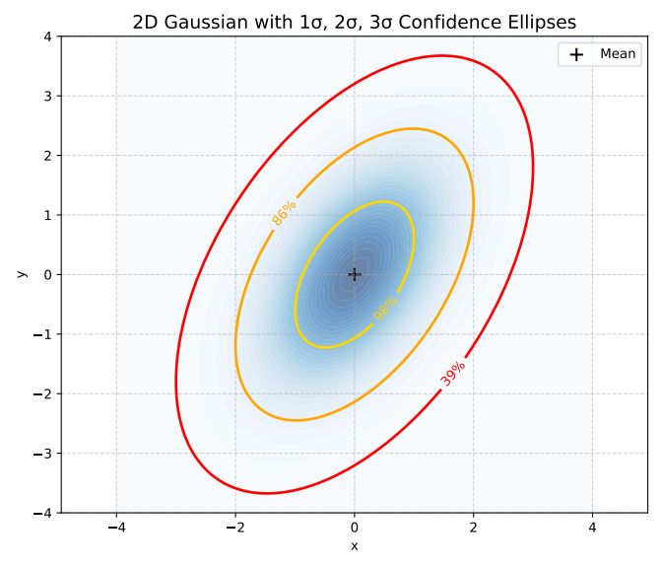
Regression
task of regression – theoretical approach
expanding near the maximum likelihood → Gaussian with
Gaussian confidence levels
  the confidence surfaces are ellipsoids:
  confidence levels in one dimension
sigma-level | 1 | 2 | 3 | 4 | 5
confidence | 68.27% | 99.54% | 99.73% | 99.9937% | 99.99994%

Slide 176
Regression
task of regression – theoretical approach
Gaussian confidence levels and chi-squared distribution
probability to be inside with the incomplete Gamma function
in Python: scipy.special.gammaincc

Slide 177
Regression
task of regression – theoretical approach
calculation with Gaussian distribution: practical rules
  assume y is Gaussian
  introduce zero-mean variables
  expected values:
  higher expected values are product of pairs!
  e.g.:

Slide 178
Regression
task of regression – theoretical approach
hypothesis checking with chi-squared distribution:
  assume Gaussian hypothesis and the data model are correct
  treat the labels as independent random variables
  compute expected value of chi-squared
chi-squared value over degrees of freedom is one

Slide 179
Regression
Linear regression

Slide 180
Linear regression
simplest relation: linear function
data are
assume linear relation:
coefficient a is an matrix, b is a vector
task to find the value (distribution or likelihood) of the coefficients
simplest case, in lot of cases very powerful

Slide 181
Linear regression
one-dimensional case
simplest: 1D linear regression, diagonal correlation matrix
problem: data and labels are real numbers
assume there is a linear relation between the two:
chi-squared function
likelihood is Gaussian in a,b:

Slide 182
Linear regression
1D linear case
computation: introduce new notations
  sum of inverse variances:
  averaging:
  correlation:

Slide 183
Linear regression
1D linear case
computation:
  and are independent Gaussian variables
  the distribution of the variable y=ax+b (with fixed x) is also Gaussian

Slide 184
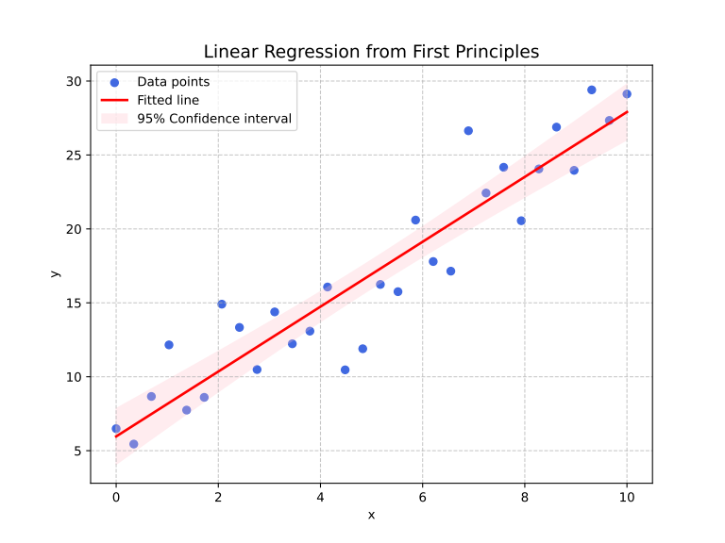
Linear regression
1D linear case
interpretation:
  best slope value and variance
  chi-squared expected value

Slide 185
Linear regression
higher dimensional linear case
data are
assume linear relation:
coefficient a is an matrix, b is a vector
calculation and formulae remain the same

Slide 186
Linear regression
higher dimensional linear case
example:
then the result is
# linear regression in 2D
Ndata = 100
a = np.array([[1, 2],[3, 4]])
b = np.array([1,-1])
x = np.random.uniform(0,1, size=(2, Ndata))
noise = np.random.normal(0,0.1, size=(2, Ndata))
y = a@x + noise + b[:,None]
barx = np.mean(x, axis=1)
bary = np.mean(y, axis=1)
Cxx = (x-barx[:,None])@(x-barx[:,None]).T/2
Cyx = (y-bary[:,None])@(x-barx[:,None]).T/2
a1 = Cyx@np.linalg.inv(Cxx)
b1 = bary - a1@barx
omega1, b1

Slide 187
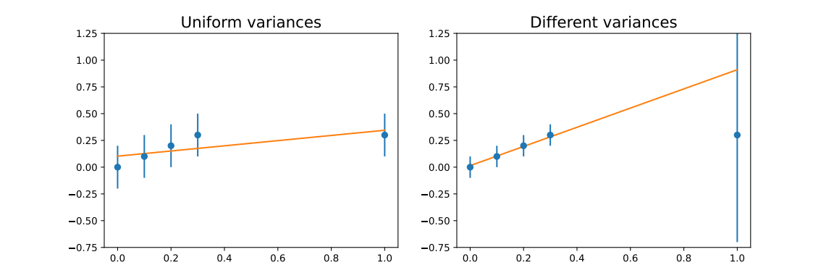
Linear regression
role of the individual variances
effect of different variances → weight importance of points
variance
  measurement (tedious)
  theoretical considerations (e.g. relative error is )
  user expectations (e.g. some points are important)

Slide 188
Linear regression
role of the individual variances
correlation matrix from measurements:
  assume that the data are i.i.d. normal
  distribution of is normal with → estimate for mean
  mean of → → variance

Slide 189
Linear regression
fitting in a functional basis
in lot of applications the task is to fit a function in a basis
one-dimensional case: function, basis, and we seek :
examples:
  polynomial expansion: → linear fit uses 2D basis
  Fourier expansion:
  Laplace transformation:

Slide 190
Linear regression
fitting in a functional basis
the basis elements should be linearly independent, i.e.
in practice we have data pairs
solve , which means minimize
once we get the coefficients, we can interpolate:
(prediction)

Slide 191
Linear regression
fitting in a functional basis
computation (more elegant than the linear case … )
  introduce vector notation

Slide 192
Linear regression
fitting in a functional basis
computation (more elegant than the linear case … )
  extremum:
  solution: (→ c.f. linear case)
  for uniform correlation matrix:

Slide 193
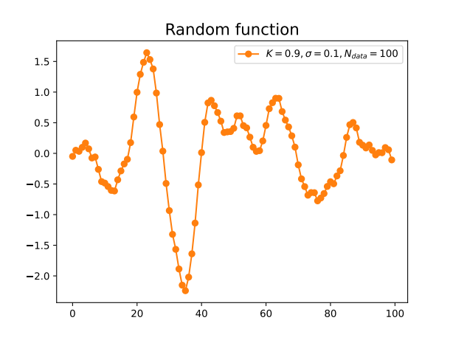
Linear regression
fitting in a functional basis
example:
  create a random function, e.g. damped oscillator with noise
  choose functional basis, e.g. sin-cos
  use the fit formulae

Slide 194
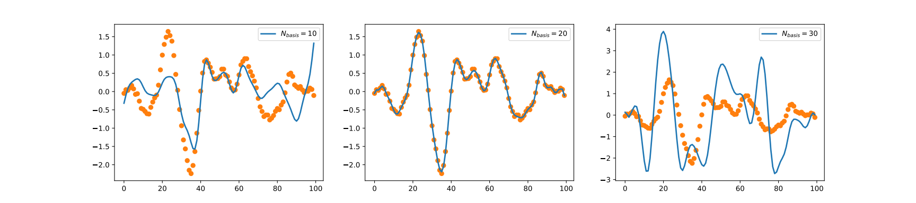
Linear regression
fitting in a functional basis
example:
  result depends on the number of basis elements → non-monotonic!

Slide 195
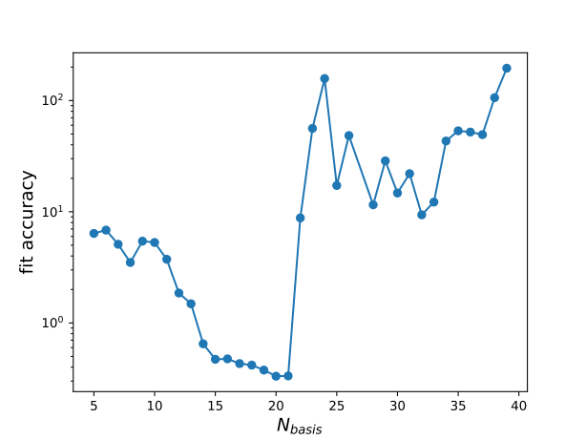
Linear regression
fitting in a functional basis
example:
  result depends on the number of basis elements → non-monotonic!

Slide 196
Linear regression
fitting in a functional basis
what happened?
  we have to invert a matrix:
  what if there are small eigenvalues?

Slide 197
Linear regression
eigenvalues and eigenvectors in nutshell
eigenvectors are stabile directions of a matrix
eigenvectors form a complete basis (in most numerical cases)
matrix functions, defined with Laurent series

Slide 198
Linear regression
eigenvalues and eigenvectors in nutshell – special cases
hermitian matrices: → real symmetric matrices
  eigenvalues are real
  eigenvectors are orthogonal
matrices:
  hermitian
  eigenvalues are non-negative (positive definite)

Slide 199
Linear regression
fitting in a functional basis
what happened?
  we have to invert a matrix:
  what if there are small eigenvalues?
a linear equation → how reliable is it?
add an eigenvector to the solution!
if numerical tolerance is →
if can be very large!

Slide 200
Linear regression
fitting in a functional basis
typical value:
  measurement errors
  numerical calculation errors
ill-conditioned matrices: there are eigenvalues
the inverse is not reliable!
very common in higher dimensions! → in ML or AI
never use the naive linear equation solving formulae!

Slide 201
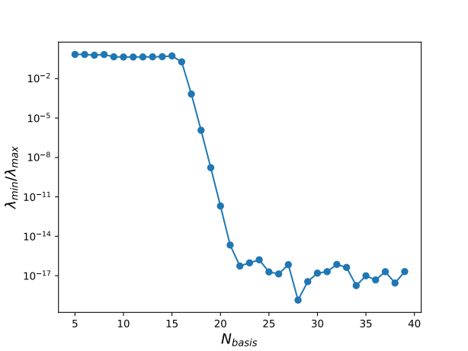
Linear regression
fitting in a functional basis
in our example: for we reached Python’s precision
after that value the fitting precision is drastically reduced

Slide 202
Linear regression
fitting in a functional basis
what can we do with an ill-conditioned matrix?
  pseudo-inverse
  regularization

Slide 203
Linear regression
pseudo-inverse
assume we can add the smallest eigenvector(s) with arbitrary coefficients
choose that value that leads to the smallest length
lesson: we should leave out all small eigenvectors!
in formula:

Slide 204
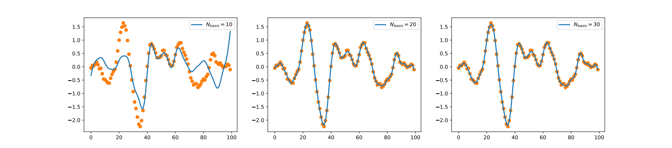
Linear regression
# pseudoinverse fitting
nus = np.linspace(1,30,Nnu)
base1 = [[np.cos(np.pi*nu*n/Ndata) for n in range(Ndata)] for nu in nus]
base2 = [[np.sin(np.pi*nu*n/Ndata) for n in range(Ndata)] for nu in nus]
f = np.array(base1+base2).T
c = np.linalg.pinv(f.T@f)@f.T@y
plt.plot(f@c)
pseudo-inverse
in Python code

Slide 205
Linear regression
pseudo-inverse works well, but closely connected to linear algebra
more general method: regularization
idea: add extra term to the loss function
  stabilize result
  spoils close connection to data
  tradeoff: should use in a balanced manner
most frequently used: L1,L2 regularization, MEM

Slide 206
Linear regression
L2 regularized loss
formally: add a small number to the matrix to be inverted
works only for positive definite matrices (true in our case)

Slide 207
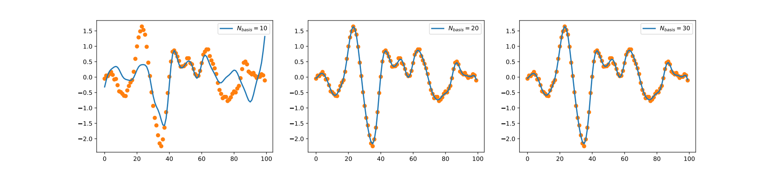
Linear regression
L2 regularized loss results

Slide 208

Linear regression
L1 regularized loss (LASSO) → for positive definite matrices
minimization with numerical methods

Slide 209
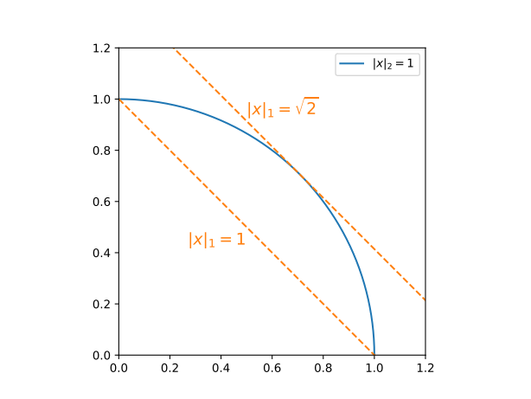
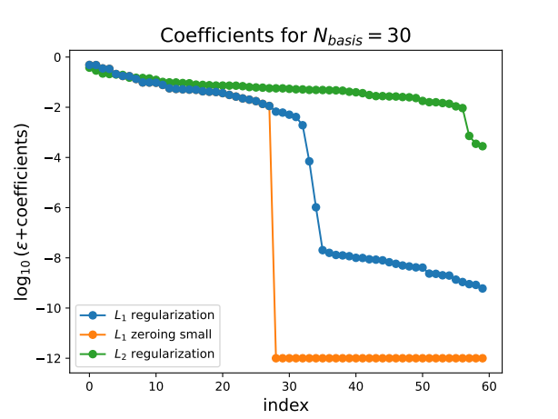
Linear regression
L1 regularization benefit: likes small coefficients
reason:
can be used to eliminate features → c.f. previous plot

Slide 210
Linear regression
interpolation vs. extrapolation
after function fitting we can predict values
data lay in
  interpolation: prediction for
  extrapolation: prediction for
dangers of interpolation → overfitting
dangers of extrapolation → …

Slide 211
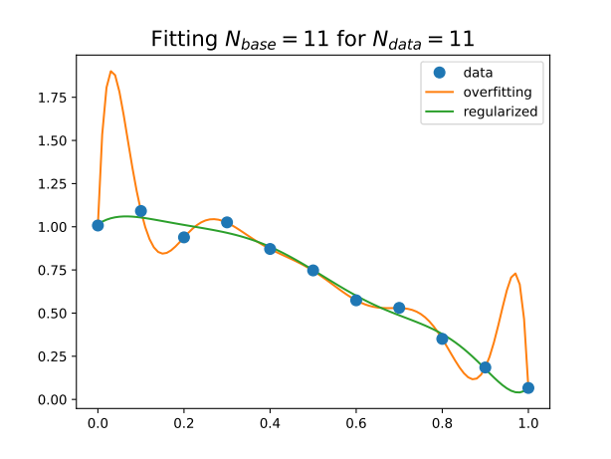
Linear regression
dangers of interpolation → overfitting
example: fit polynomial basis to data points
original model with
fitted model:
with and or without regularization
result:
  exact fit, hits all points → bad interpolation
  worse at the edges
  regularization helps

Slide 212
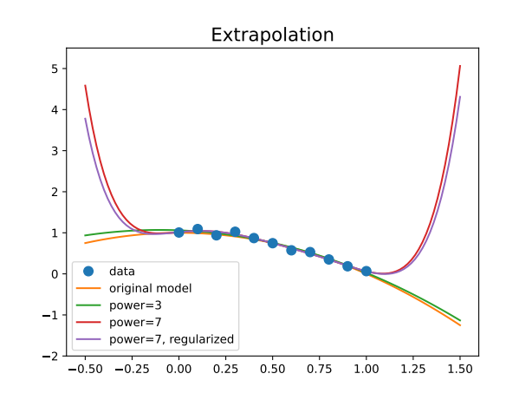
Linear regression
dangers of extrapolation → avoid extrapolation
fitting lower and higher order polynomials
results:
  inside the data range all fits are correct
  outside all fail
  the more robust (fewer parameters)
  the better
  regularization does not help!

Slide 213
Linear regression
dangers of extrapolation → avoid extrapolation
fitting lower and higher order polynomials
results:
  inside the data range all fits are correct
  outside all fail
  the more robust (fewer parameters)
  the better
  regularization does not help!
☠️ proceed and perish!⚠️

Slide 214
Linear regression
controlling extrapolation
  use bounded basis → avoid polynomials!
  require asymptotic behaviour (i.e. function form at infinity)
  → transforms extrapolation to interpolation
  use the model requiring the fewest parameters (robust modelling)
  extend data in a sensible way

Slide 215
Nonlinear regression

Slide 216
Nonlinear regression
we can have a general data model
minimize
no direct methods → recursive approach
  steepest descent method
  random algorithms → Metropolis method with simulated annealing
  challenges at higher dimensions

Slide 217
Steepest descent method
iteration
  choose a starting point
  establish an iteration
  try to ensure that
in steepest descent method: linear approximation around
length of a vector → choose
in linear approximation

Slide 218
Steepest descent method
advantages:
  simple, low cost
  requires only first derivative → numerically or automatic differentiation
  flexible: stochastic and mini batch versions in high dimensions
disadvantages:
  slow (linear convergence), especially near minimum
  for ill-conditioned functions long iteration path → conjugate gradient
  sensitive to local minima → use momentum (Nesterov acceleration)
  can lead to runaway solutions → adaptive step size, gradient clipping

Slide 219
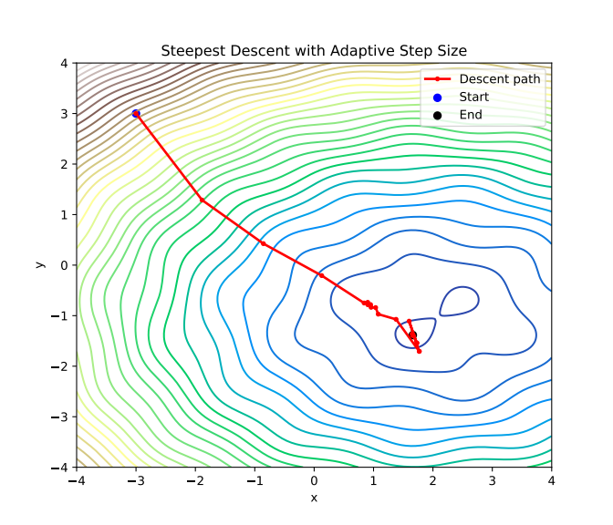
Adaptive step length
in the iteration change the step length r
  if → choose
  else choose
  if or stop iteration
2D example with

Slide 220
Simulated annealing
choose a random direction and a positive number
if → choose
else still accept with a probability
T is the “temperature” controlling exploration
the values in have a distribution
  can be used in Monte Carlo simulation (Metropolis algorithm)
if we need the minimum, decrease T → simulated annealing (SA)

Slide 221
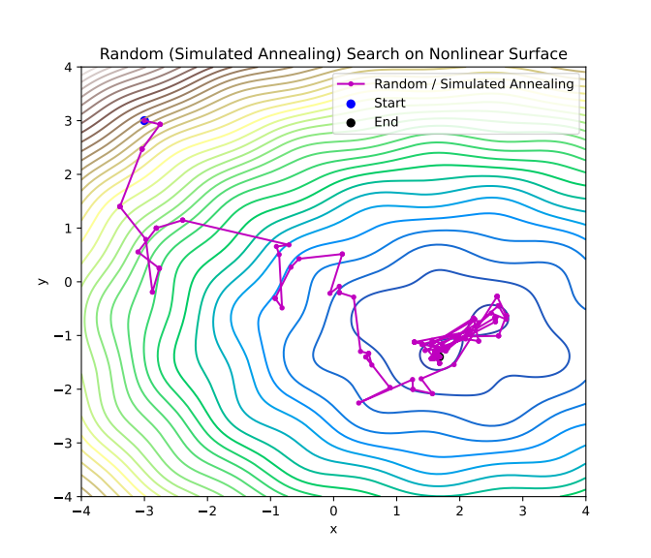
Simulated annealing
the same example as before
advantages:
  no gradient is needed
  can escape local minima
  parallelizable
drawbacks:
  slow convergence
  difficult to use in batch methods → rarely used in DNNs

Slide 222
Feature optimization
Perceptron
Support Vector Machine
Extreme Learning Machine

Slide 223
Linear Features
we can tailor features instead of the original ones
simplest: linear combination → looks for a hyperplane to separate classes
can be generalized → curved separator surface
implementation:
  perceptron (linear)
  Support Vector Machine (linear + nonlinear)
  Extreme Learning Machine (ELM) (nonlinear)

Slide 224
Perceptron
one of the first AI algorithm (Rosenblatt, 1958)
→ newspapers: “the electronic brain that can walk, talk, see, write, reproduce itself, and be conscious of its existence”
idea:
  two classes with labels , data are d dimensional
  look for a vector w and a constant b that satisfies
  possible loss function to be maximized
  Rosenblatt’s algorithm: if we find a misclassified point

Slide 225
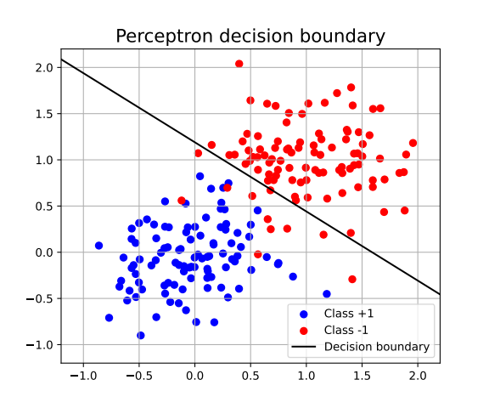
Perceptron
example: 2D points
accuracy: 95.5%

Slide 226
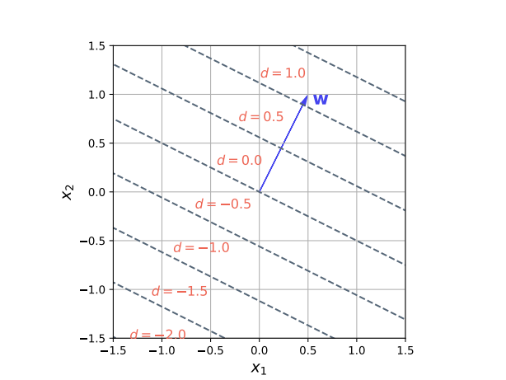
Support Vector Machine
improved perceptron to maximize margin
logic:
  define a w vector → the selective coordinate is
  try to separate the two sets using this feature
  for optimal w use 1D methods (e.g. hinge loss)
  in the training use the nearest point to write
  up w → support vectors
  Python package: svm

Slide 227
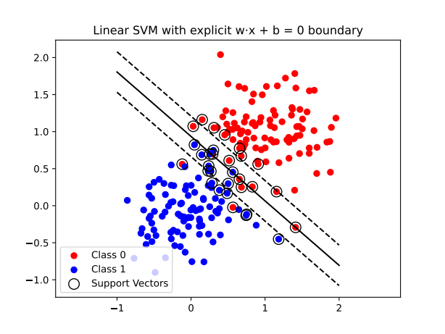
Support Vector Machine
# Support Vector Machine example
from sklearn import svm
from sklearn.metrics import accuracy_score
clf = svm.SVC(kernel='linear', C=1.0)
clf.fit(X, y)
# 🔮 Predict on the test set
y_pred = clf.predict(X_test)
# 🧮 Evaluate
acc = accuracy_score(y_test, y_pred)
→ acc = 96.5%

Slide 228
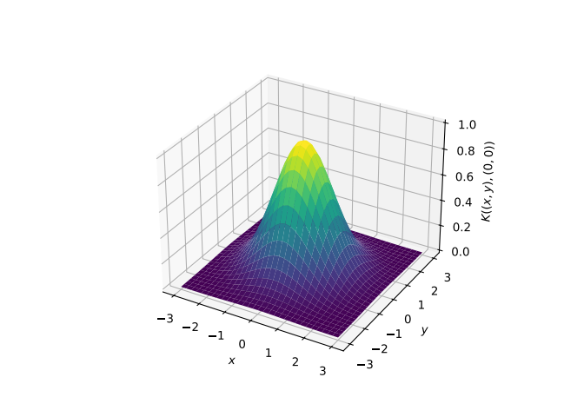
Support Vector Machine
we can use also nonlinear combinations (kernel)
most used: Gaussian kernel
  around each point we take a “bump”
  complete kernel is a linear combination
  (using ±1 as labels)
  resulting surface is a landscape with
  hills and valleys
  in practice it is enough to consider only a small number of points (support vectors) to represent the surface

Slide 229
Support Vector Machine
we can use arbitrary kernel
fitting and learning:
  linear combination parameters are learned using data
  kernel parameters are fixed in the learning process, and tuned for best performance (using grid search, cross validation)
  Deep Neural Networks work in a similar manner, there the functional space is a nested (layered) function composition.
  decision based on a single (although) complicated feature

Slide 230
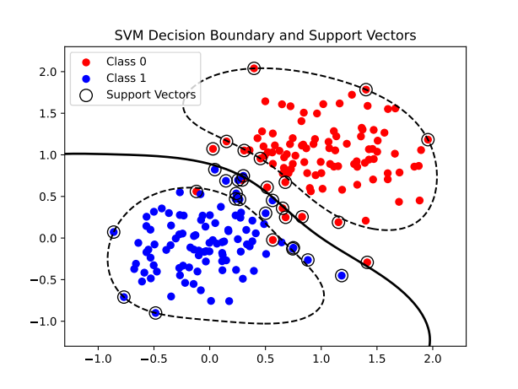
Support Vector Machine
in the code we should use the ‘rbf’ kernel (Radial Basis Function)
# Support Vector Machine example
from sklearn import svm
from sklearn.metrics import accuracy_score
clf = svm.SVC(kernel='linear', C=1.0)
clf.fit(X, y)
# 🔮 Predict on the test set
y_pred = clf.predict(X_test)
# 🧮 Evaluate
acc = accuracy_score(y_test, y_pred)
→ acc = 97.5%

Slide 231
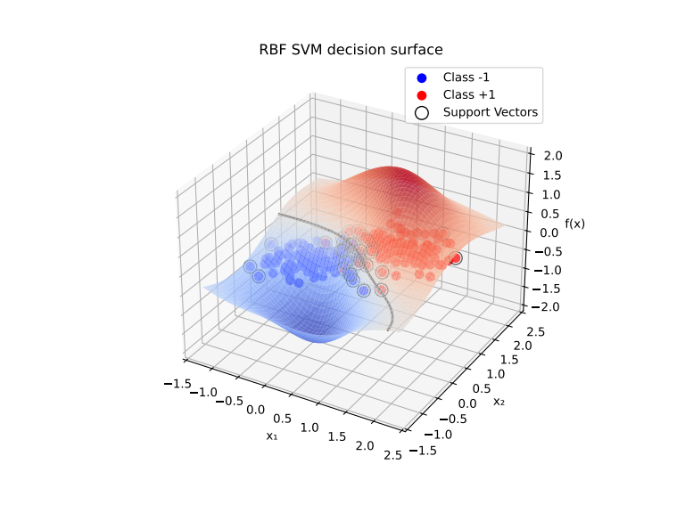
Support Vector Machine
in the code we should use the ‘rbf’ kernel (Radial Basis Function)

Slide 232
Extreme Learning Machine
what is the best basis to represent the output?
  perceptron, linear SVM → linear basis
  nonlinear SVM → arbitrary fixed kernel
DNNs: multilayer structure → preceding layers + last layer
  preceding layers → generate the basis, fitted to the problem
  last layer → use linear combination of basis elements
Extreme Learning Machine (ELM)
  use a random basis → technically a layer with fixed weights

Slide 233
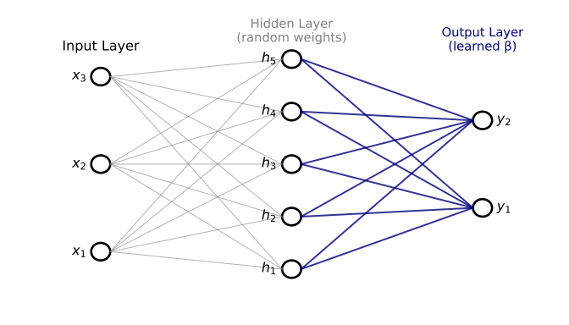
Extreme Learning Machine
data in matrix representation:
define an intermediate basis:
  is a pointwise non-linear function
  (e.g. tanh, or Gaussian)
  fixed parameters
expand Y in this basis:
  tunable parameters
  best value from minimizing the chi-squared function (use regularization!)

Slide 234
Extreme Learning Machine
simple package for ELM
# ELM package
import numpy as np
class ELM:
def __init__(self, n_hidden=50, activation=np.tanh):
self.n_hidden = n_hidden
self.activation = activation
def fit(self, X, y):
self.W = np.random.randn(X.shape[1], self.n_hidden) self.b = np.random.randn(self.n_hidden)
H = self.activation(X @ self.W + self.b)
self.beta = np.linalg.pinv(H) @ y
def predict(self, X):
H = self.activation(X @ self.W + self.b)
return H @ self.beta

Slide 235
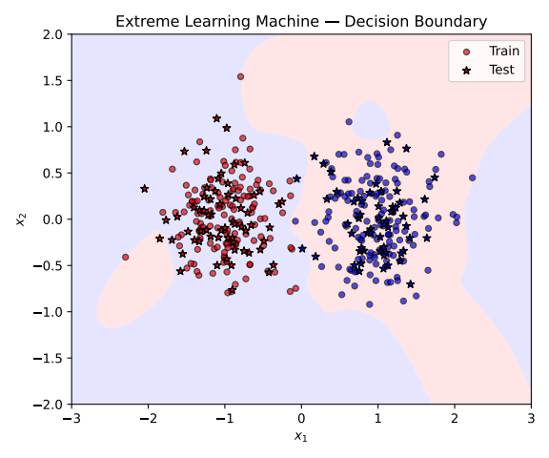
Extreme Learning Machine
example dataset
activation function: tanh
accuracy: 97%

Slide 236
Extreme Learning Machine
classification by analytic expression → several classes
class labels → analytic expressions
one-hot encoding:
  , the ith unit vector
  n classes → n dimensional output
other (vector) encodings:
  D dimensional output
  mapping is optimized by some condition (e.g. semantics for words)

Slide 237
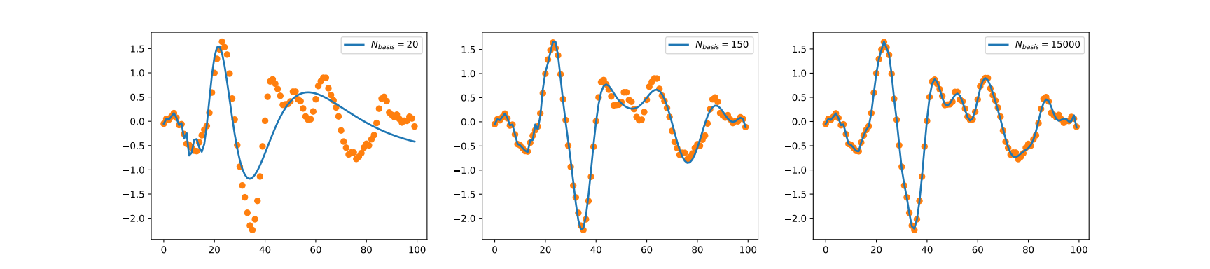
Extreme Learning Machine
function fitting with ELM
random function, and different hidden layer dimensions
basis not too effective to describe highly oscillating functions

Slide 238
Gaussian representation of data distribution

Slide 239
Gaussian Mixture Models
interconnected data are often sit in a compact region → ellipsoid
find the ellipsoid containing most of the data!
probability level → “distance”
equidistance surfaces constant → ellipsoids
generate points: →

Slide 240
Gaussian Mixture Models
technical slide: equipotential surfaces from correlation matrix
we want to satisfy
eigensystem eigenvectors orthogonal
ansatz:
verify:

Slide 241
Gaussian Mixture Models
technical slide: generate data with given
  data with normal distribution:
  transform it
  check:
  for 2D data we can directly specify the direction:
# generating Gaussian with given mu and C
def generate_Gaussian(mu, C, Ndata):
dim=mu.shape[0]
xi = np.random.normal(0,1, (dim, Ndata))
lam,ev =np.linalg.eigh(C)
sqrt_C = ev@np.diag(np.sqrt(lam))@ev.T
return sqrt_C@xi + mu

Slide 242
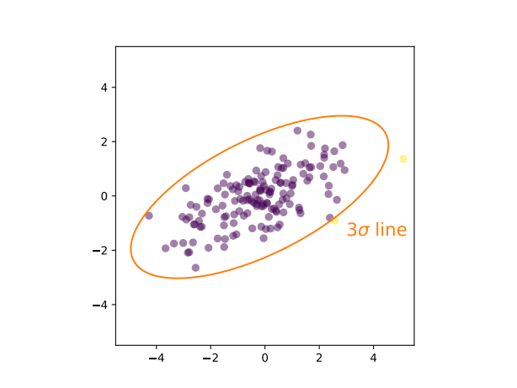
Gaussian Mixture Models
example: 2D points
  generate points
  numerically determine correlation matrix and eigensystem
  draw ellipses containing 99% of data → about 3σ in 2D

Slide 243

Gaussian Mixture Models
if we have several classes → Naive Bayes models
  assume that each class are independent and points lie in an ellipsoid → can be represented by Gaussian distribution
  determine the probability to belong to each classes separately
# Naive Bayes classification
from sklearn.naive_bayes import GaussianNB
nb = GaussianNB()
nb.fit(X_train, y_train)
y_pred = nb.predict(X_test)
→ accuracy: 96%

Slide 244
Gaussian Mixture Models
unsupervised generalization → GMM
  assume the probability distribution is a sum of Gaussian terms
  fix the number of clusters → do not provide labels (unsupervised)
  find the best parameters by maximizing the likelihood
  we need convex combinations
  use Expectation–Maximization (EM) algorithm

Slide 245


Gaussian Mixture Models
# Gaussian Mixture Models
from sklearn.mixture import GaussianMixture
gmm = GaussianMixture(n_components=2, covariance_type='full', random_state=0, n_init=10)gmm.fit(X)
example: clustering in 2D

Slide 246
Gaussian Mixture Models
technical slide: the Expectation–Maximization (EM) algorithm
  start from an initial guess
  compute “responsibilities”
  (closest component weight)
  redefine parameters
  (attract to closest cluster)
  repeat until converges

Slide 247


Gaussian Mixture Models
technical slide: the Expectation–Maximization (EM) algorithm

Slide 248


Principal Component Analysis (PCA)
choose an orthonormal coordinate system aligned with the data!
we fitted an ellipsoid → find the eigenvectors
  smallest eigenvalues: data vary the least
  largest eigenvalues: data vary the most

Slide 249
Principal Component Analysis (PCA)
PCA: keep only largest eigenvalues
  compression → descriptive features
  noise reduction
  representation of the largest changes
small eigenvalues:
  approximately constant for all data in a class
  classification → selective features
  laws

Slide 250
Principal Component Analysis (PCA)
technical slide: compression with PCA
eigenvalue = projection value squared
PCA values: for the largest eigenvalues → fewer data

Slide 251

Principal Component Analysis (PCA)
technical slide: data reconstruction with PCA
most information is in the subspace of largest eigenvalues
therefore
# PCA representation of data
from sklearn.decomposition import PCA
pca = PCA(n_components=1)
data_pca=pca.fit_transform(data.T)
data_reconstructed=pca.inverse_transform(data_pca)

Slide 252

Principal Component Analysis (PCA)
classification with laws → LLT
smallest eigenvectors of the PCA matrix → laws
classification features:
  if small value
  if usually a larger value
so is the smallest for the true class index
  if r=1: distance from the centre

Slide 253
Examples from Computer Vision

Slide 254
Examples from Computer Vision
After learning the most important ML methods, let us apply them!
Possible application area: Computer Vision (cv)
Examples of popular databases:
  sklearn’s load_digits dataset
  sklearn’s fetch_lfw_people dataset
  MNIST dataset

Slide 255

load_digits dataset
database properties
  contains images of handwritten characters: 0-9 (10 classes)
  contains 1797 sample, 8x8 grayscale (4 bit) images
  originally collected by the UCI Machine Learning Repository in the 1980s–1990s, from scanned postal code digits and forms
  one of the first machine learning benchmark studies for optical character recognition (OCR), preceding MNIST
  in Python available as
  from sklearn.datasets import load_digits

Slide 256


load_digits dataset
basic classifiers
  train KNN, RF and SVM on the data
  very good results!

Slide 257
load_digits dataset
accuracies:
method | accuracy
DT | 82.0%
RF | 96.0%
Bagging | 92.2%
AdaBoost | 82.0%
KNN (k=5) | 98.4%
SVM (RBF kernel) | 98.9%
NaiveBayes | 82.3%
ELM (30k hidden) | 98.7%
LLT | 98.4%

Slide 258


load_digits dataset
data compression and reconstruction → PCA
PCA 13 component reconstruction

Slide 259
Lessons and conclusions

Slide 260
Conclusions and lessons
there are a lot of models for few degrees of freedom
most powerful
  for classification: RF, KNN, SVM → ELM, LLT
  compression: PCA
  unsupervised clusterization: GMM
for lot of degrees of freedom: lose efficiency
solution: hierarchical approach, process a small portion per step
  deep neural networks: translation (CNN) + scaling (pooling)
  LLMs: attention heads

Slide 261

Philosophy of artificial intelligence
why do we need intelligence? why not science? how do we approach to our environment?

Slide 262
Understanding the world
evolution: living world adapts to its environment, non-conscious
nerve system: possibility of evolution within the same creature
action-focused adaptation → intelligence
  plants, simpler animals
  there comes sensory information from the environment (e.g. direction of light or humidity)
  processing and direct action → e.g. turning towards light
  also present in higher order creatures → “System I” (D. Kahneman)
  present-day neural networks work in this way

Slide 263
Understanding the world
sensory
information
processing
information
action
improvement
evaluation

Slide 264
Understanding the world
in a very complicated environment it is not feasible!
  survival can depend on a tiny detail
  improved sensory information (seeing, hearing)
  too many situation to be adapted to all one-by-one!
solution: representing reality in a faithful enough way
  necessary biological improvement: brain (central nervous system)
  representation (model) ≠ world!
  scenarios can be run on the models (thinking): intelligence ≠ thinking
  action only after evaluation of the imaginary scenarios
  “System II” of Kahneman

Slide 265
Understanding the world
sensory
information
internal model
processing
information
action
improvement
evaluation

Slide 266
Understanding the world
consider scenarios
sensory
information
updating
internal model
result 1
processing
information
result 2
improvement
…
evaluation
action
decision

Slide 267
Understanding the world
System II vs. System I
  slower – faster
  conscious – instinctive (“gut feeling”)
  error and self control – error prone
  planning, thinking – gut feeling
examples:
  driving beginner vs. expert
  walking fast vs slow

Slide 268
Understanding the world
Modelling the world
human understanding – pre-science:
  the world is chaotic, we just feel, how it works
  schools, ateliers, workshops → personal skills matter
  all action is “art” from painting to castle-building
  (e.g. dome building of Hagia Sophia)
  as contrary: divine order → strict order and law valid only among gods

Slide 269
Understanding the world
Scientific approach
law and order also valid on the Earth
mathematics (formal logics) can be applied for natural phenomena, and the calculations agree with reality!
the laws are simple if we are smart enough (Occham’s razor)
  physics (mechanics, thermodynamics, etc)
  chemistry (atoms, molecules, periodic table)
  order in biology, taxonomy, genetics
Pluralitas non est ponenda sine necessitate.
(Plurality is not to be posited without necessity)
→ William of Occham

Slide 270
Understanding the world
Scientific worldview
  apparently complicated phenomena are understandable by revealing how its parts work (→ clockwork)
  understanding = analysis
  complexity is apparent: real entities (ontologically) are the components – ultimately the most elementary constituents of the model.
  all is science, from human to Theory of Everything (ToE)
  ToE? → can be the Standard Model of particle physics!
Do we understand everything?

Slide 271
Understanding the world
The particle physicist and grandma’s cake
  grandma can bake cake, despite she does not know SM
  physicist can not bake cake, although he understands SM → why??
  cake consists of huge number of quarks, gluons, photons, electrons → must be extremely complicated!
  but still: the fact that grandma understands cake baking demonstrates that it is not so difficult…
The scientific worldview must be flawed somewhere – but where? Where is the catch?

Slide 272


Understanding the world
Check the claims
  2- or 3-atom system is more complicated than a single atom system
  atom system is extremely complicated
  a system of atoms can be a gas, which is simpler to describe than an atom itself!
  MOREOVER: the description of the gas has nothing to do with the description of an atom!
  (that is why the existence of atoms is not evident!)

Slide 273
Understanding the world
Mathematical background
  consider a car: it is very complicated
  from the distance (e.g. from the point of view of traffic) it can be modelled as a point with certain properties
  lesson: the farther an object is, the less its properties matter!
  Seen from afar, objects appear more purified and simple.
  for atoms:
    at microscopic scale it is extremely complicated
    at large scale only a few properties survive (the would-be conserved quantities)

Slide 274
Understanding the world
consequence: scientific disciplines relate to one another much like software to hardware.
  hardware does not follow from software
    a software can run in a lot of machine
    software is not aware of the hardware details
  software does not follow from hardware
    a hardware platform supports a wide range of software
    hardware is not influenced by the software
    although a software appears on the hardware level, but it is very complicated

Slide 275
Understanding the world
Scientific disciplines are relates as software to hardware
But the software and hardware are independent!
The world cannot be fully understood analytically.
Facit: the Standard Model is NOT the ToE
(only the part relevant on its own scale)

Slide 276
Understanding the world
all phenomena must be understood independently
the number of relevant features depends solely on the given phenomenon (simplicity is not guaranteed)
science is applicable if the number of features is small
  all feature has its own unique role
  the system is understandable: determine the relevant features by some measurements, the rest is prediction!

Slide 277
Understanding the world
if the number of relevant features is not small
  the distinct identity of each feature becomes less clear
  the same phenomena can be represented by many different models
  none of these models are completely exact
  there is no single, unique model of reality
  scientific principle does not work
this is the realm of artificial intelligence

Slide 278









Understanding the world
point mechanics
~ 5 relevant
chemistry, biology
20-? relevant
nuclear physics
20-? relevant
natural environment
? relevant ? irrelevant
Ising model
3 relevant
Standard Model
21 relevant (symmetries!)
face recognitions
~ 30000 irrelevant
geometric images
~ 10-100 irrelevant

Slide 279
Understanding the world
Realm of Science
point mechanics
~ 5 relevant
chemistry, biology
20-? relevant
nuclear physics
20-? relevant
natural environment
? relevant ? irrelevant
Ising model
3 relevant
Standard Model
21 relevant (symmetries!)
face recognitions
~ 30000 irrelevant
geometric images
~ 10-100 irrelevant

Slide 280
Understanding the world
Realm of Intelligence
point mechanics
~ 5 relevant
chemistry, biology
20-? relevant
nuclear physics
20-? relevant
natural environment
? relevant ? irrelevant
Ising model
3 relevant
Standard Model
21 relevant (symmetries!)
face recognitions
~ 30000 irrelevant
geometric images
~ 10-100 irrelevant

